Slide 1
EISA
Entrega

Slide 2
Methods

Slide 3
QuasR
Alignment (QuasR)
genomeFile: Bsgenome.Mmusculus.UCSC.mm10
Aligner: Rhisat2
Count exons and introns (QuasR)
getRegionsFromTxDb: TxDb.Mmusculus.UCSC.mm10.knownGene
strandedData = TRUE
orientation = same
Returned 18693 genes

Slide 4
Statistical analysis
edgeR: Gaidatzis’s method
Identify quantifiable genes
Normalisation: scale to mean library size, log transform [+ pseudocount of 8]
+/- filter: Select if rowmean > TH for both exons and introns – TH set as 5.0 in original method, this might miss out genes with little intron to start with
Δ exon, Δ intron
NLex = log2(exon count); NLin = log2(intron count)
Dex (changes in steady state mRNA) = NLex (compared ie. LPS) – NLex(reference)
Din (changes in transcriptional rates) = NLin (compared ie. LPS) – NLin (reference)
Dex.Din (post-transcriptional changes) = Dex – Din
Estimate model parameters in edgeR using only quantifiable genes
Or one-step EISA with eisaR

Slide 5
Decisions regarding algorithm/parameters used
Quantification: salmon vs QuasR
Both algorithms identified similar significant genes (90% overlap).
QuasR was used.
To filter or not to filter
If we consider only significant (FDR < 0.05) genes, correlation between the samples is quite high for both Δ exon and Δ intron. The number of genes identified is also similar (around 500 genes are missed if we use a filter: miss out exons that are not normally expressed in non-stressed state?).
The following results are generated without a filter.
Differential expression: DESEQ2 vs EdgeR vs limma-voom
All 3 algorithms identified similar significant genes (80-95% overlap).
EdgeR was used.
EISA: one-step eisaR vs step-by-step with EdgeR
EdgeR was used. eisaR was too much of a black box.

Slide 6
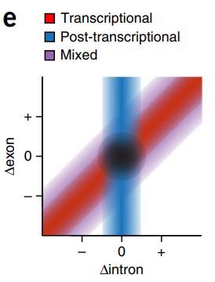
Main findings
Nascent transcription seems to decrease upon LPS treatment of both WT and H14 cells
Total intron in treated samples less than total intron in untreated
Mean Δ intron < 0
More genes have decreased Δ intron after treatment
Changes in expression are largely due to changes in nascent transcription rather than post-transcriptional modifications
Pearson coefficient of plot of Δexon against Δintron for both WT and H14 cells is close to 1
SITA not obvious in both WT and H14 cells
From “Analysis of intronic and exonic reads in RNA-seq data characterizes transcriptional and post-transcriptional regulation.“ by Gaidatzis D et al., 2015, Nat Biotechnol. Jul;33(7):728

Slide 7
WT: trt vs untrt

Slide 8
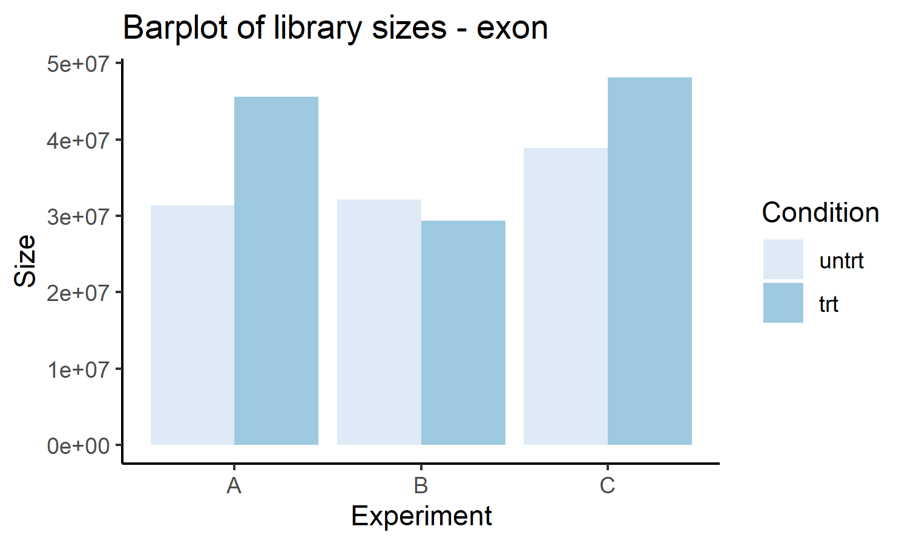
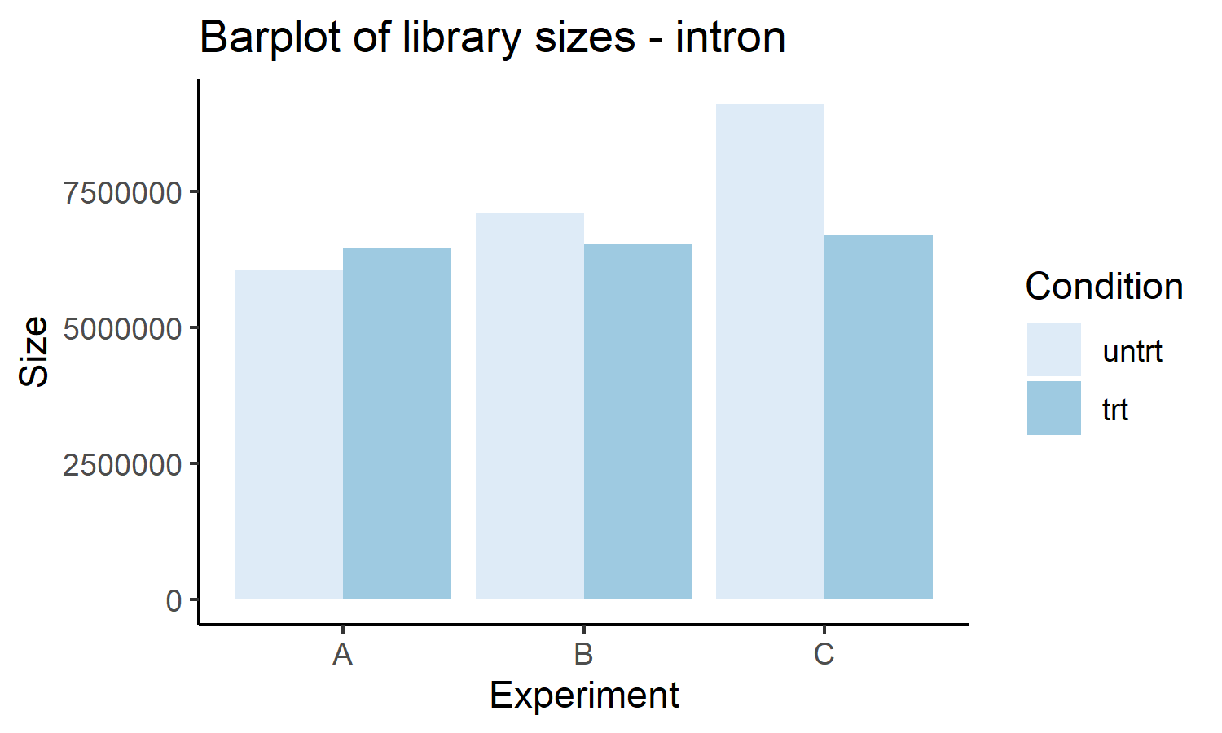
Sample details
Sample description
 | Filename | Cell | LPS | Expt
Sample 1 | WT_S1 | WT | No | A
Sample 2 | WT_S2 | WT | No | B
Sample 3 | WT_S3 | WT | No | C
Sample 4 | Wt-LPS-S4 | WT | Yes | A
Sample 5 | Wt-LPS-S5 | WT | Yes | B
Sample 6 | Wt-LPS-S6 | WT | Yes | C
Total count |  | Δ exon, Δ intron
 | Interpretation | A |  | B |  | C
 |  | Sample 1 | Sample 4 | Sample 2 | Sample 5 | Sample 3 | Sample 6
Total exons | Steady state mRNA | 31317398 | 45560209 | 32163255 | 29410141 | 38850126 | 48156533
Total introns | Nascent transcription | 6041266 | 6462774 | 7110487 | 6546633 | 9104240 | 6682582
Fraction of introns | Checks to make sure things are within normal ranges | 0.1617 | 0.1242 | 0.1810 | 0.1821 | 0.1899 | 0.1219
Summary |  | Min | 1st quartile | Median | Mean | 3rd quartile | Max
 |  | 0.1219 | 0.1336 | 0.1714 | 0.1601 | 0.1818 | 0.1899

Slide 9
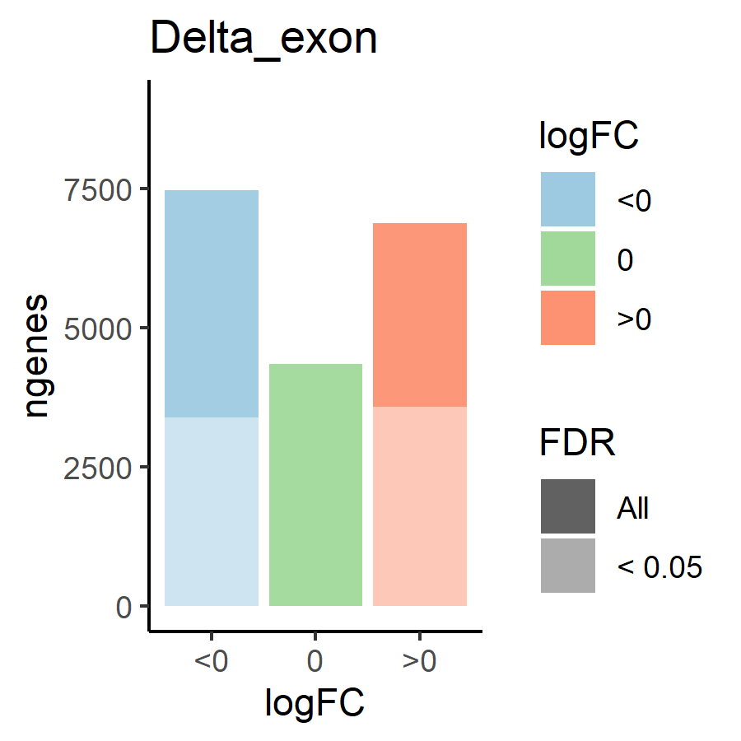
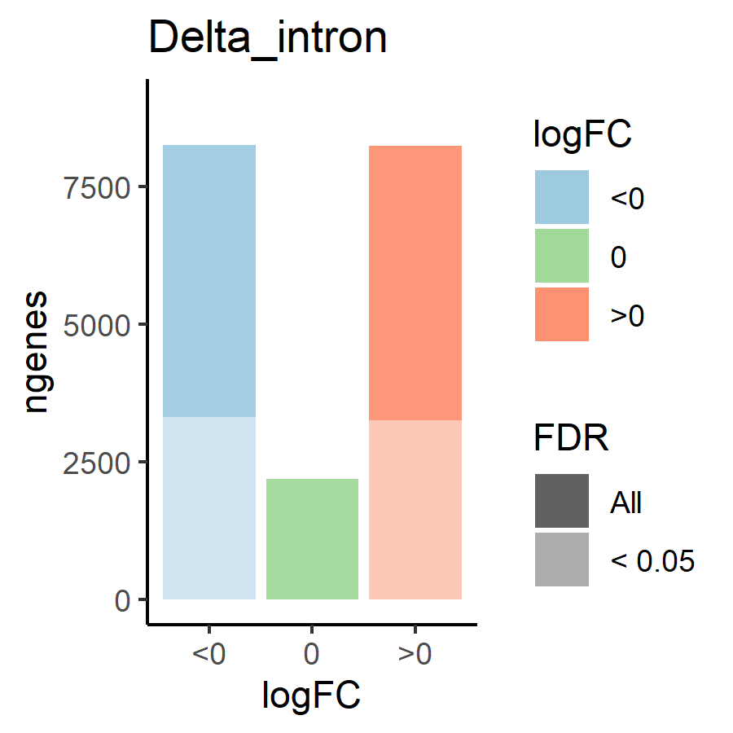
Differential expression: Δ exon and Δ intron
 |  | Δ exon (steady state mRNA) |  | Δ intron (nascent transcription)
 |  |  | FDR < 0.05 |  | FDR < 0.05
Genes included |  | 18693 | 6977 | 18693 | 6562
Corr | A v B | 0.934 | 0.974 | 0.865 | 0.943
 | A v C | 0.934 | 0.972 | 0.883 | 0.952
 | B v C | 0.924 | 0.970 | 0.873 | 0.948
Δ | > 0 | 6873 | 3580 | 8239 | 3250
Δ intron < 0 | < 0 | 7469 | 3397 | 8255 | 3312
Δ intron = 0 | = 0 | 4351 | 0 | 2199 | 0
 | Mean | -0.1219 | -0.1242 | - 0.1498 | -0.16994
Correlation: Δ exon stronger than Δ intron
SITA or no SITA
If we only consider significant genes (FDR < 0.05): more exons are upregulated (3580) than downregulated (3397), but more introns are downregulated (3312) than upregulated (3250)
If we include genes with FDR > 0.05: more exons are downregulated (7469) than upregulated (6873), and more introns are downregulated (8255) than upregulated (8239)
But the difference is quite small, so I would say no SITA
HOWEVER
Mean of both Δ exon and Δ intron < 0 means that even though the number of downregulated genes is smaller, the magnitude of downregulation is larger than upregulation, ie. a smaller number of genes are strongly downregulated vs a large number of genes are weakly upregulated

Slide 10
Supplementary tables
Δ exon
 |  | No filter | No filter + FDR < 0.05 | Filter | Filter + FDR < 0.05
Genes included |  | 18693 | 6977 | 9144 | 6017
Corr | A v B | 0.934 | 0.974 | 0.972 | 0.982
 | A v C | 0.934 | 0.972 | 0.970 | 0.981
 | B v C | 0.924 | 0.970 | 0.964 | 0979
Δ exon | > 0 | 6873 | 3580 | 4487 | 3002
Δ intron < 0 | < 0 | 7469 | 3397 | 4657 | 3015
Δ intron = 0 | = 0 | 4351 | 0 | 0 | 0
 | Mean | -0.1219 | -0.1242 | -0.161 | -0.1228
Δ intron
 |  | No filter | No filter + FDR < 0.05 | Filter | Filter + FDR < 0.05
Genes included |  | 18693 | 6562 | 9144 | 5697
Corr | A v B | 0.865 | 0.943 | 0.924 | 0.954
 | A v C | 0.883 | 0.952 | 0.939 | 0.962
 | B v C | 0.873 | 0.948 | 0.938 | 0.965
Δ intron | > 0 | 8239 | 3250 | 4356 | 2785
Δ intron < 0 | < 0 | 8255 | 3312 | 4788 | 2912
Δ intron = 0 | = 0 | 2199 | 0 | 0 | 0
 | Mean | - 0.1498 | -0.16994 | - 0.2654 | -0.2234

Slide 11
Transcriptional or post-transcriptional regulation (Δ exon/Δ intron)
 |  | Δ exon / Δ intron
 |  | Upregulated genes (Δ exon > 0) |  |  | Downregulated genes (Δ exon < 0)
 |  | Total | FDR < 0.05 | FDR > 0.05 | Total | FDR < 0.05 | FDR > 0.05
 |  |  | Post-transcriptional | Transcriptional |  | Post-transcriptional | Transcriptional
Genes included |  | 3580 | 1415 | 2165 | 3397 | 891 | 2506
Corr | A v B | 0.780 | 0.843 |  | 0.722 | 0.839
 | A v C | 0.812 | 0.883 |  | 0.766 | 0.882
 | B v C | 0.792 | 0.858 |  | 0.732 | 0.844
Δ | > 0 | 2499 | 1156 |  | 1733 | 531
Δ intron < 0 | < 0 | 1081 | 259 |  | 1664 | 360
Δ intron = 0 | = 0 | 0 | 0 |  | 0 | 0
 | Mean | 0.1821 | 0.336 |  | 0.0663 | 0.103
Changes in expression seems to be driven by nascent transcription more than post-transcription

Slide 12
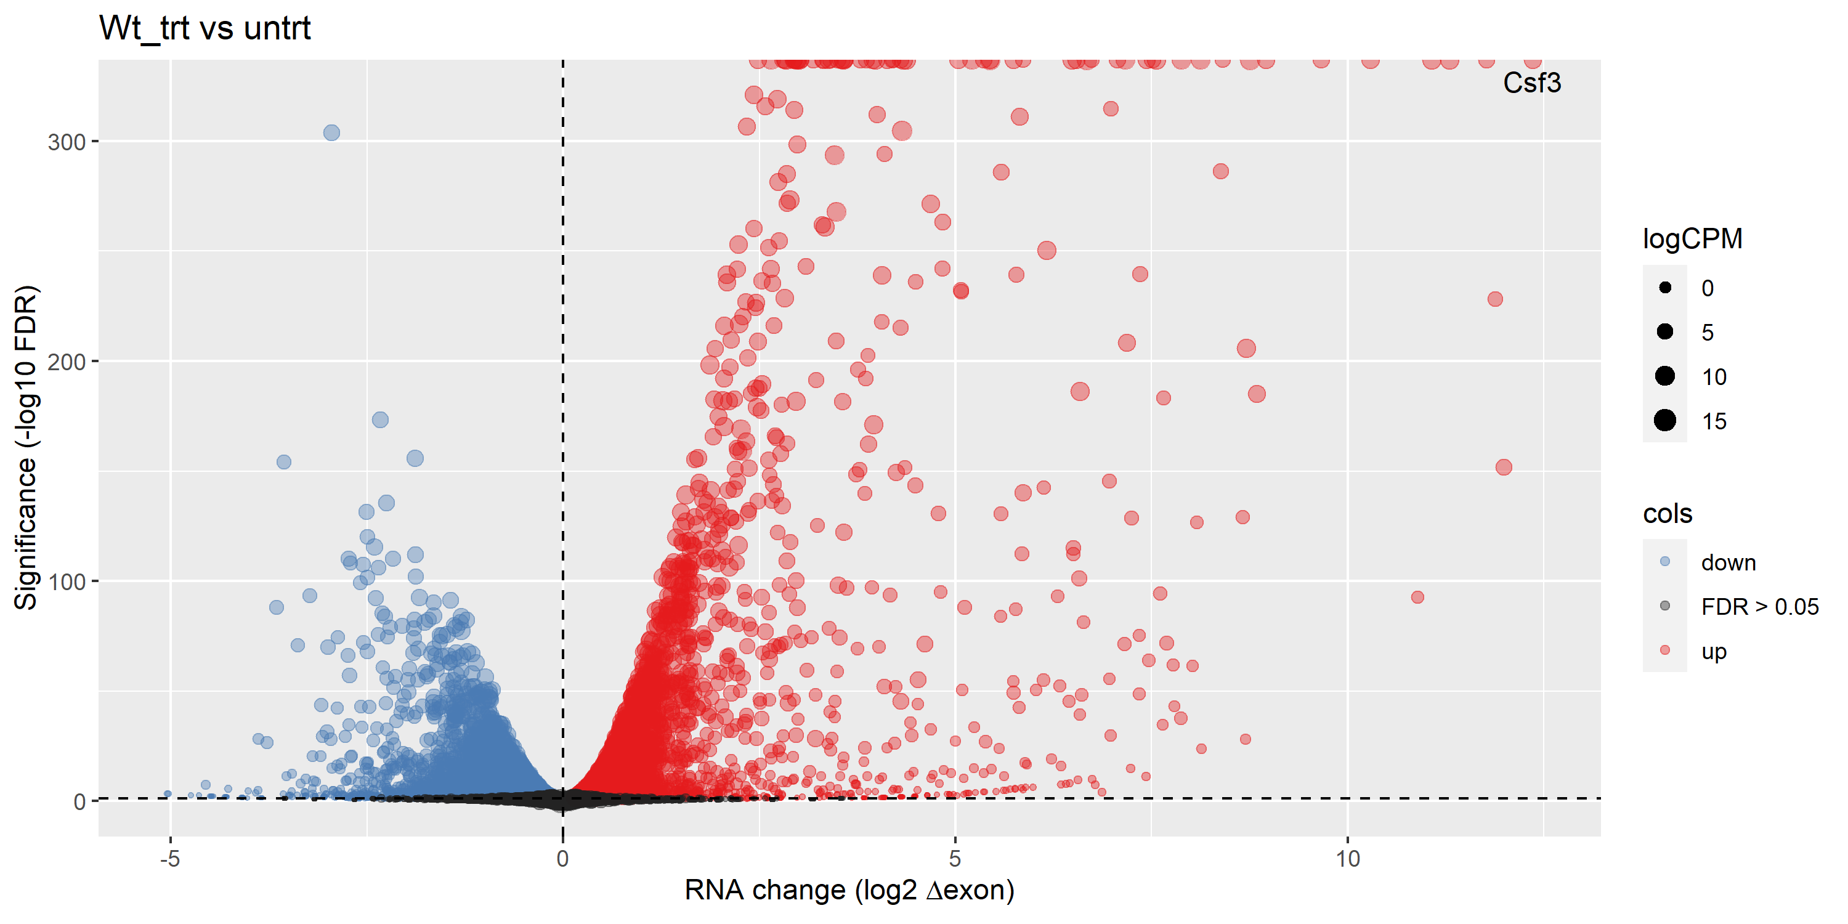
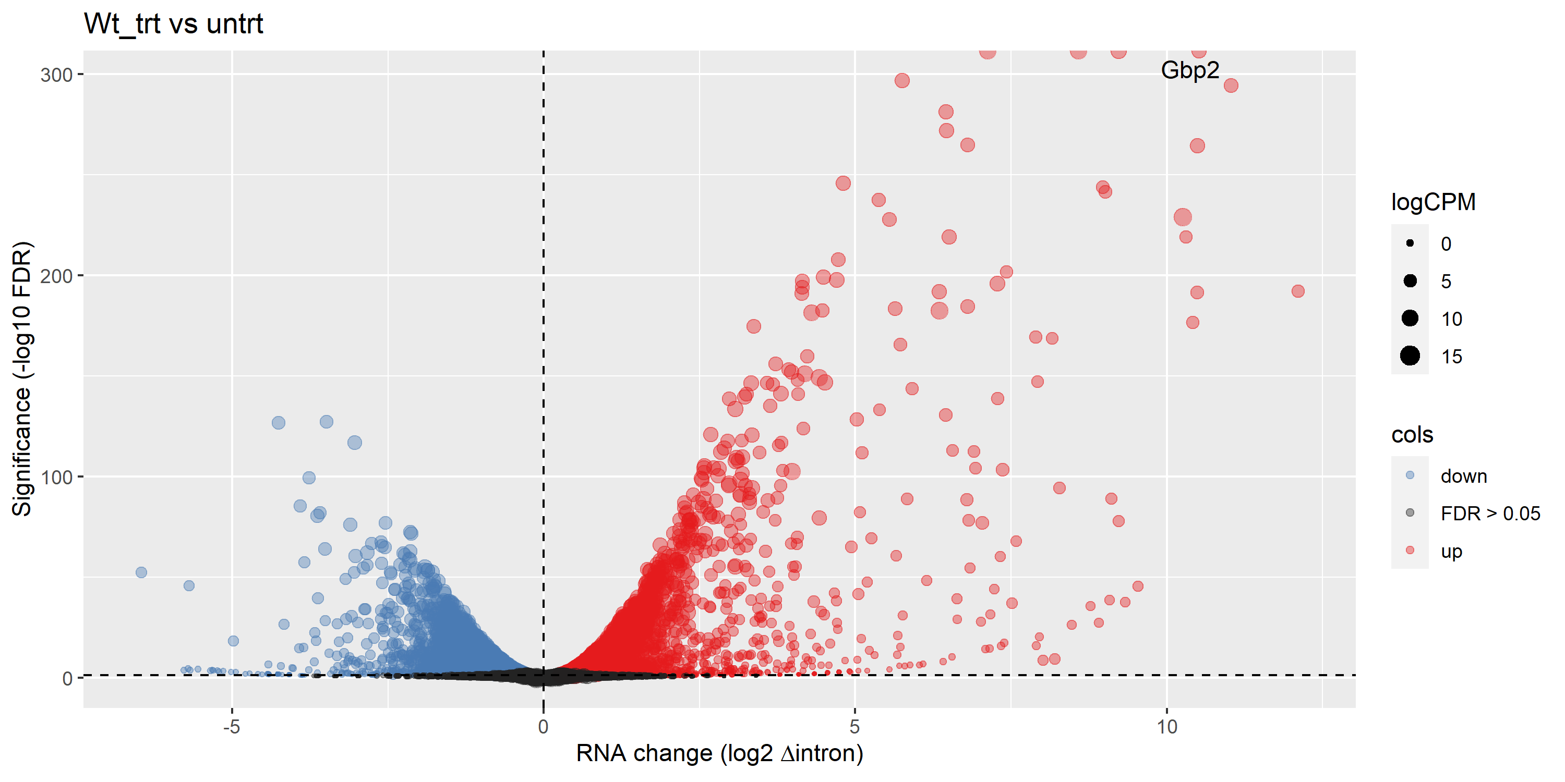
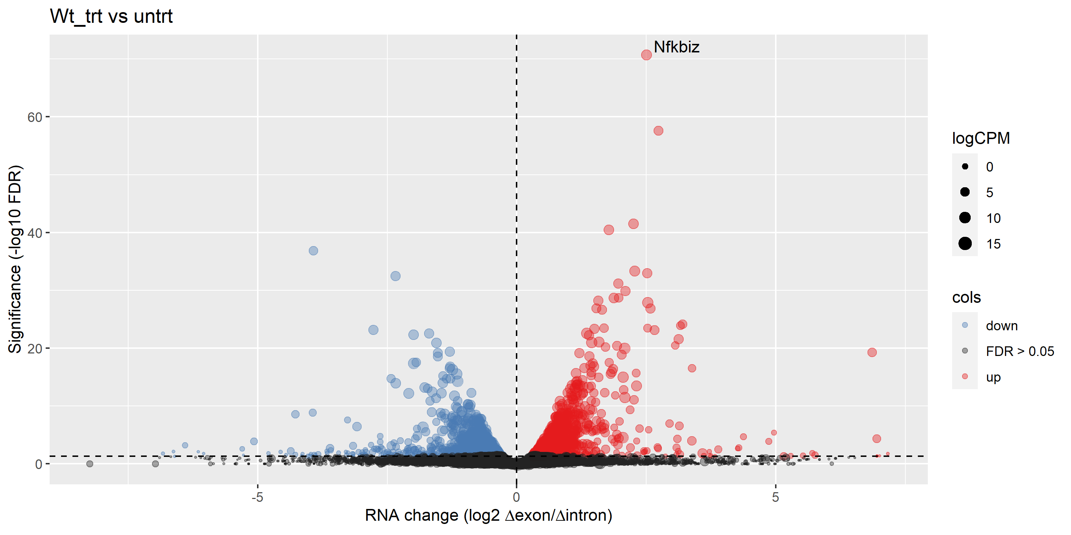
Volcano plots – no label
Exon
Up | 3580
Down | 3397
Intron
Up | 3250
Down | 3312
Differentially expressed exons and introns
- More significant red than blue -> no SITA
<- Differentially expressed exons/introns (post-transcriptionally regulated)

Slide 13
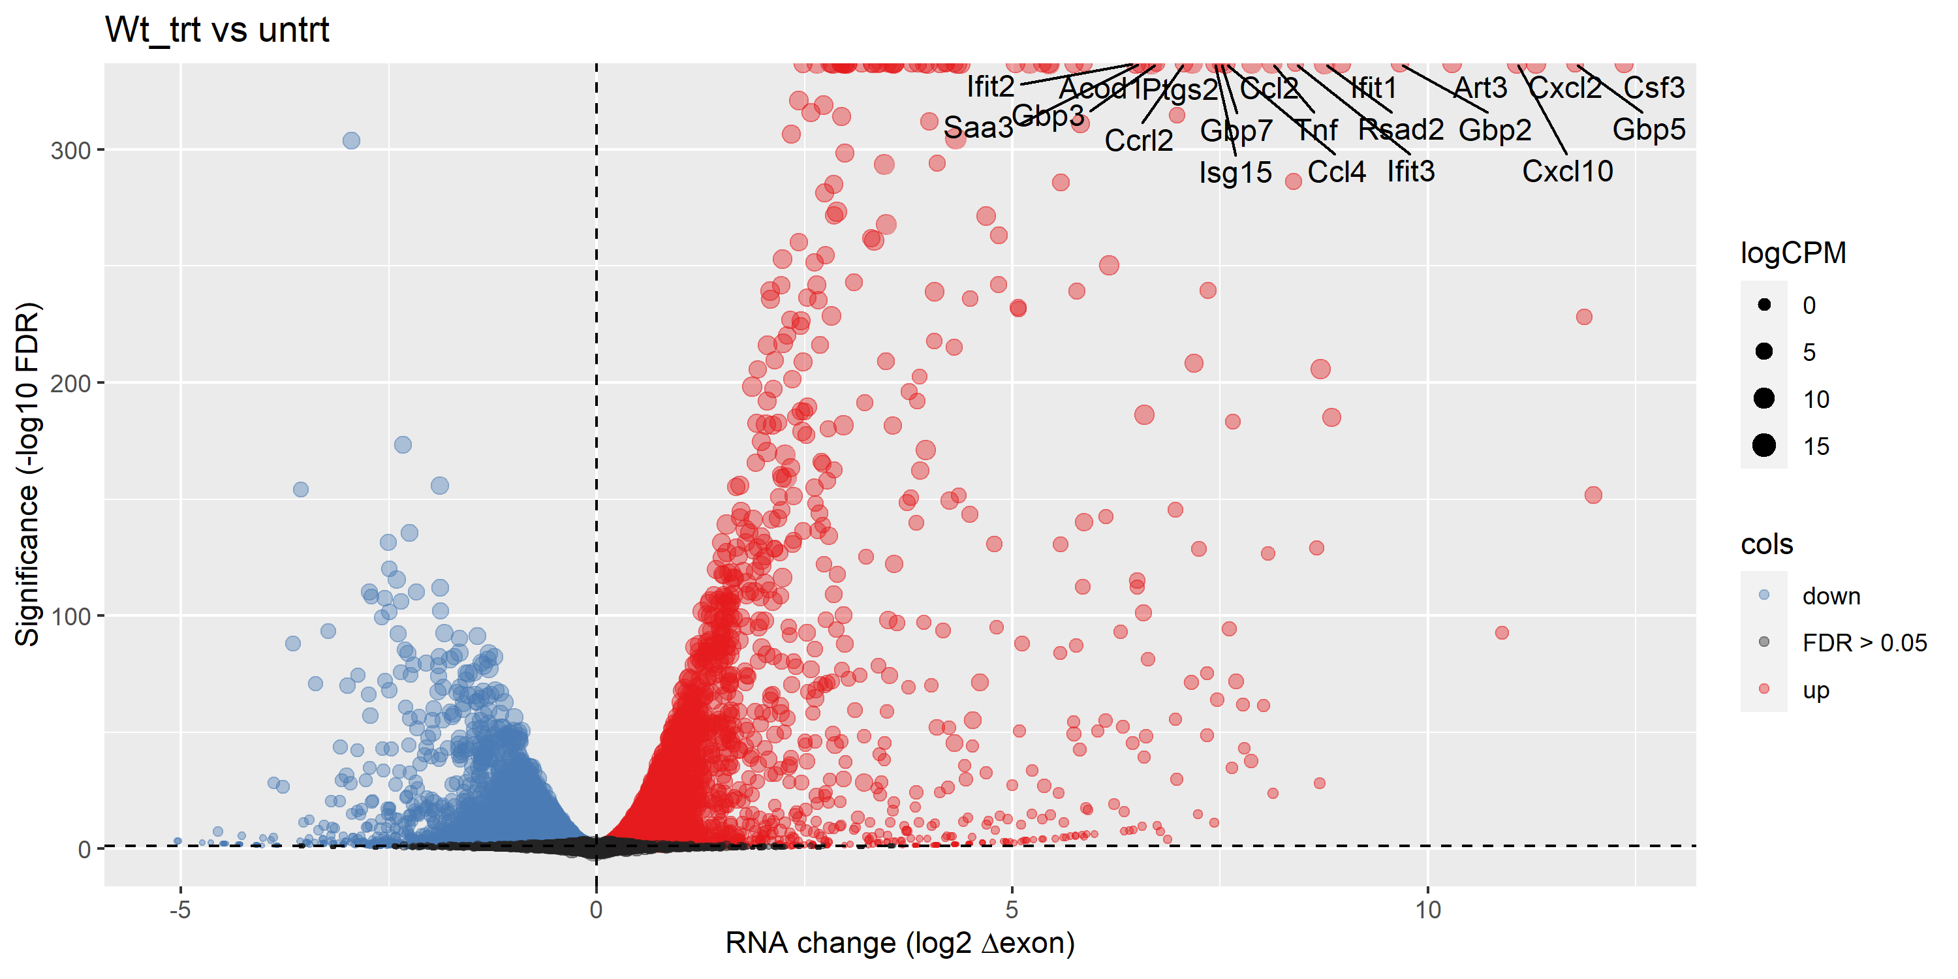
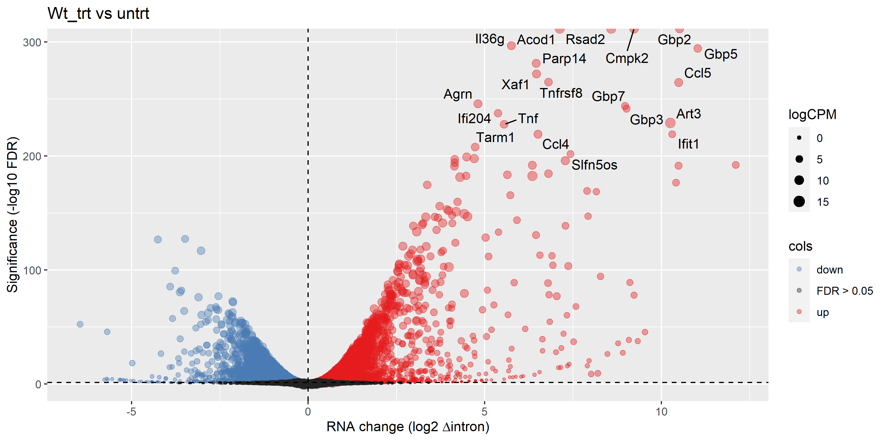
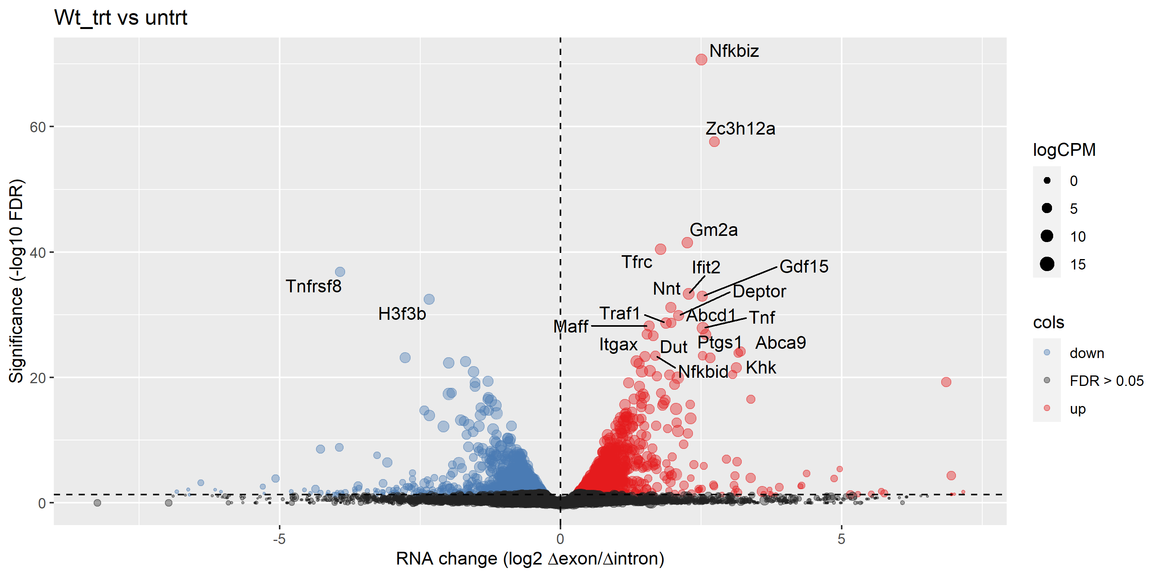
Volcano plots – top 20 genes labelled

Slide 14
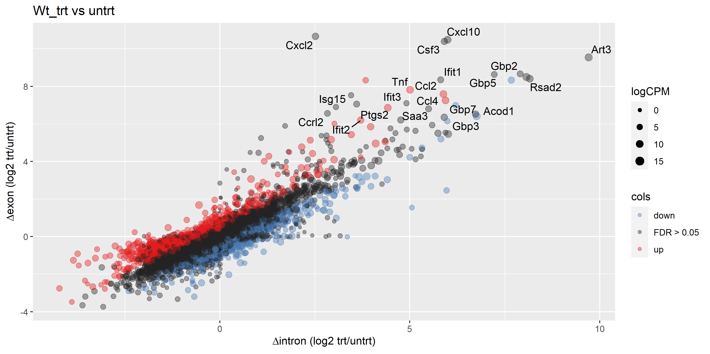
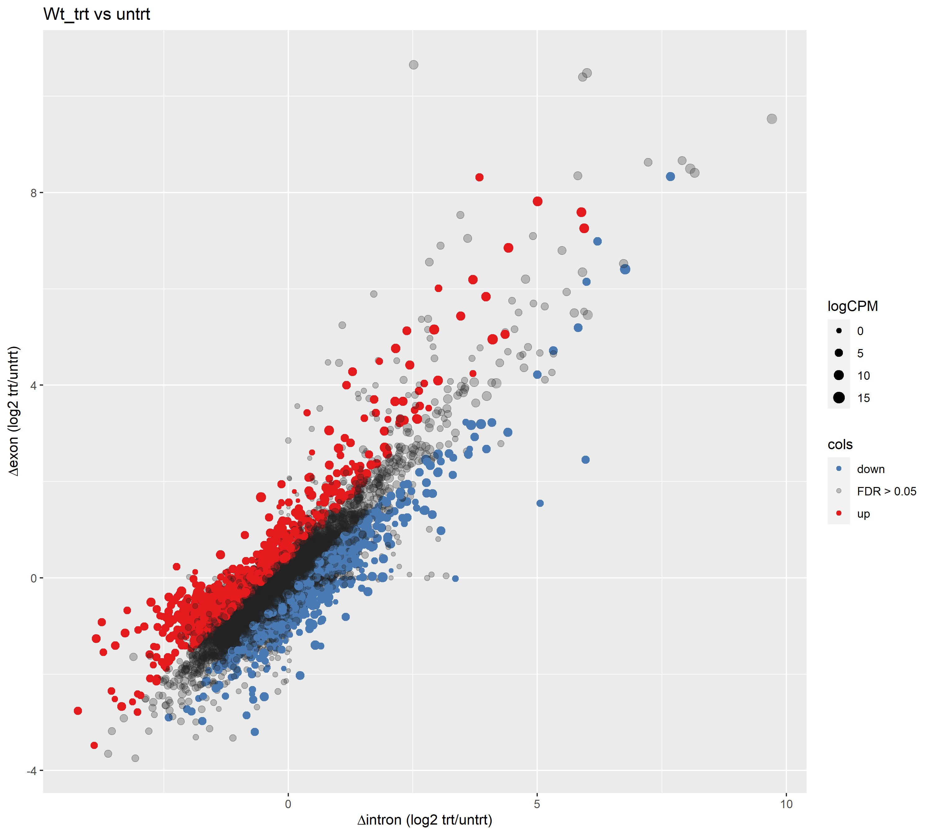
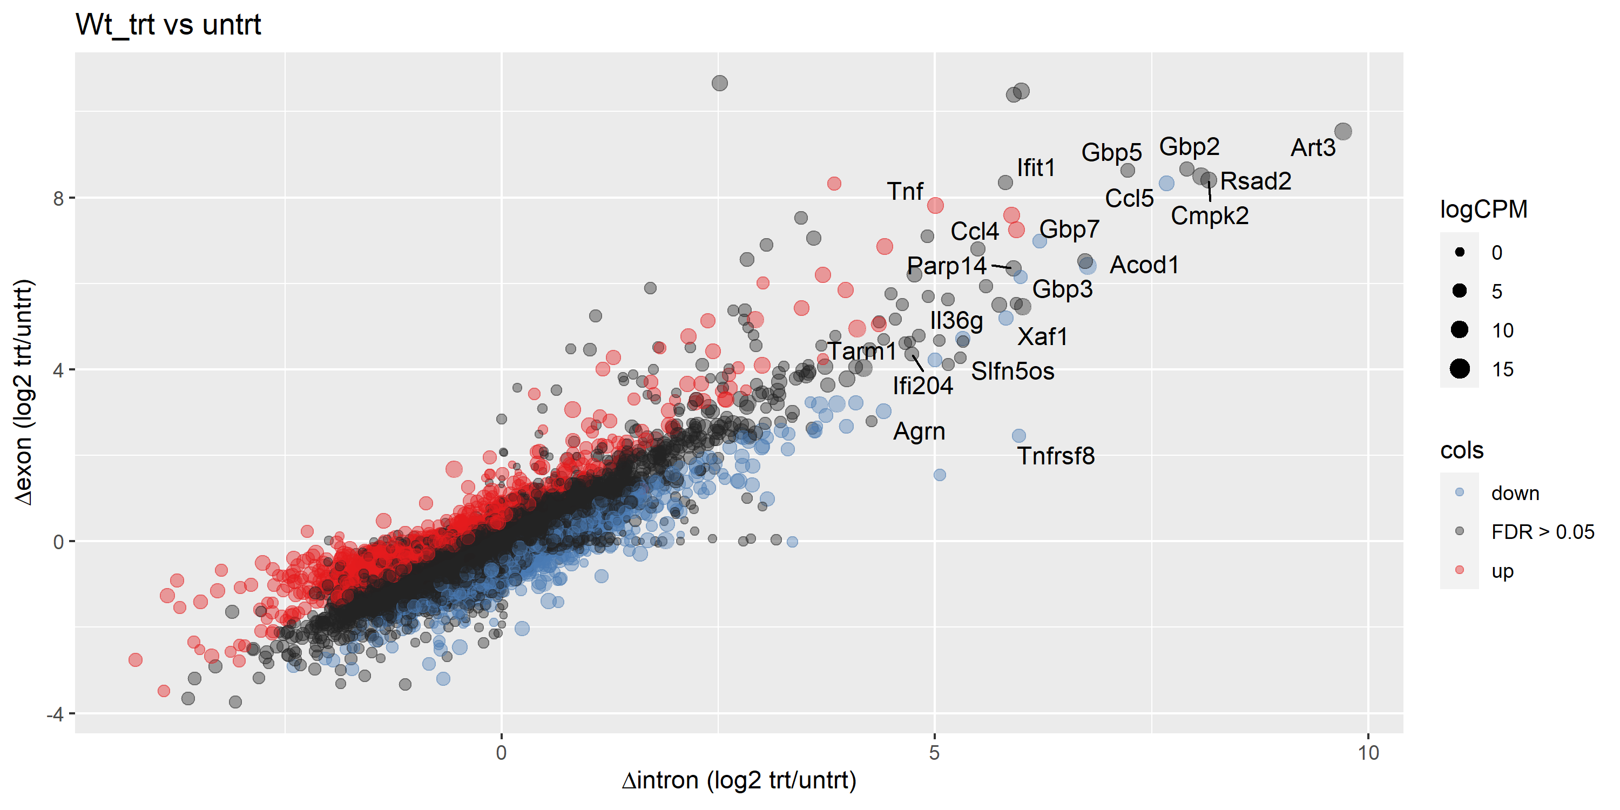
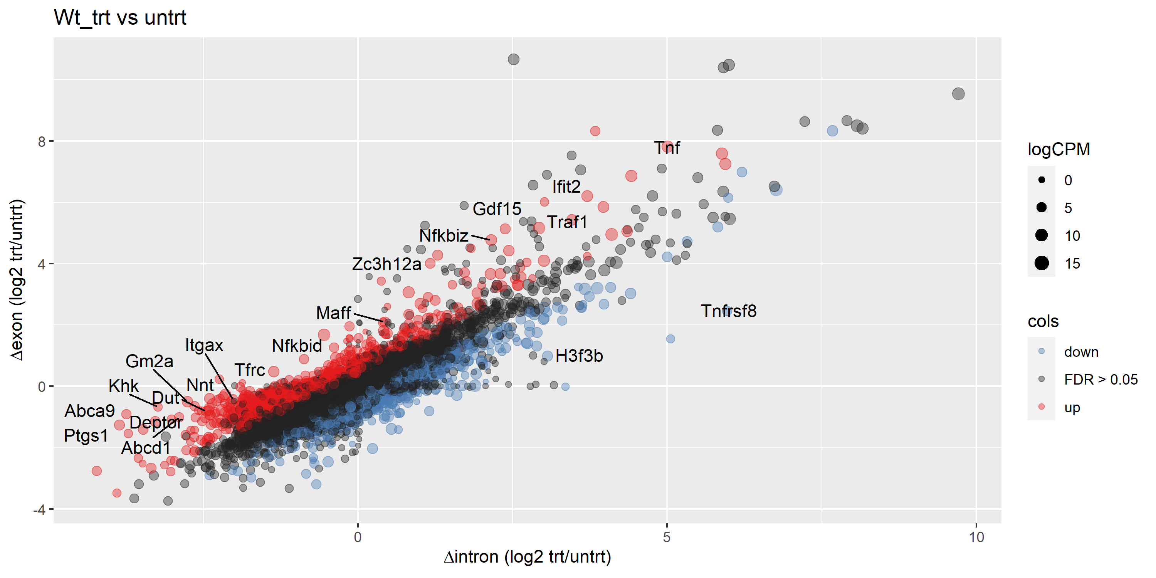
Δ exon / Δ intron plots
Top 20 differentially expressed exons
R = 0.82974
p value < 2.2e-16
Top 20 differentially expressed introns
Top 20 most likely post-transcriptionally regulated genes
Pearson coefficient close to 1: changes in expression are largely due to changes in nascent transcription rather than post-transcriptional modifications
Genes that are likely to be post-translationally regulated are coloured

Slide 15
H14: trt vs untrt

Slide 16
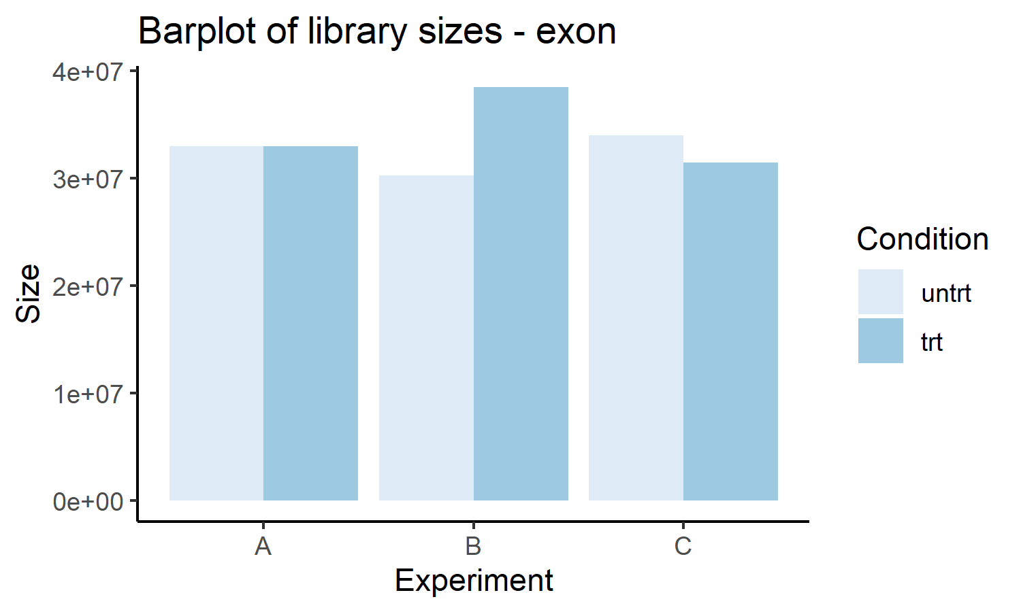
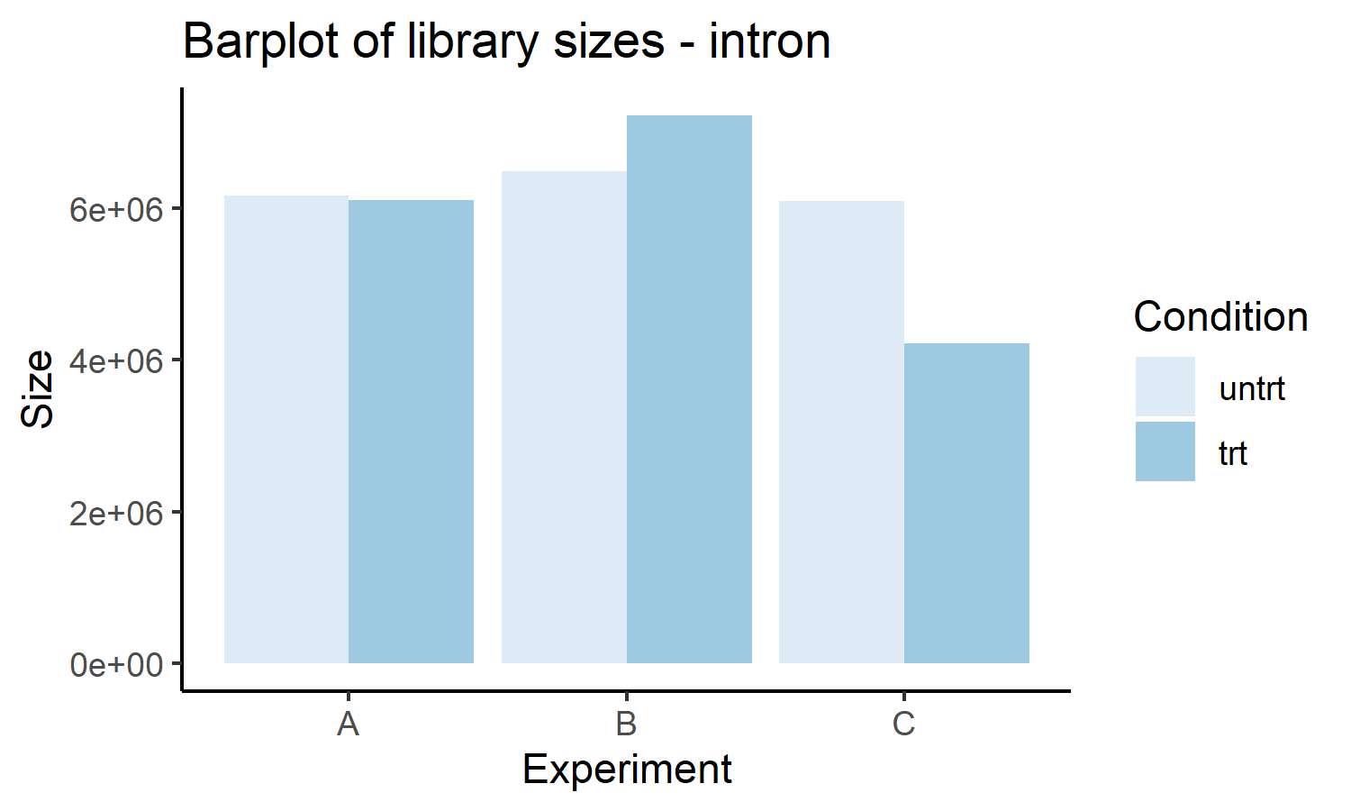
Sample details
Sample description
 | Filename | Cell | LPS | Expt
Sample 7 | H14-LPS-S7 | H14 | Yes | A
Sample 8 | H14-LPS-S8 | H14 | Yes | B
Sample 9 | H14-LPS-S9 | H14 | Yes | C
Sample 10 | H14_S10 | H14 | No | A
Sample 11 | H14_S11 | H14 | No | B
Sample 12 | H14_S12 | H14 | No | C
Total count |  | Δ exon, Δ intron
 | Interpretation | A |  | B |  | C
 |  | Sample 10 | Sample 7 | Sample 11 | Sample 8 | Sample 12 | Sample 9
Total exons | Steady state mRNA | 32958821 | 32978044 | 30279470 | 38504452 | 33972536 | 31455549
Total introns | Nascent transcription | 6158129 | 6104100 | 6477220 | 7220804 | 6085947 | 4217897
Fraction of introns | Checks to make sure things are within normal ranges | 0.1574 | 0.1562 | 0.1762 | 0.1579 | 0.1519 | 0.1182
Summary |  | Min | 1st quartile | Median | Mean | 3rd quartile | Max
 |  | 0.1182 | 0.1530 | 0.1568 | 0.1530 | 0.1578 | 0.1762

Slide 17
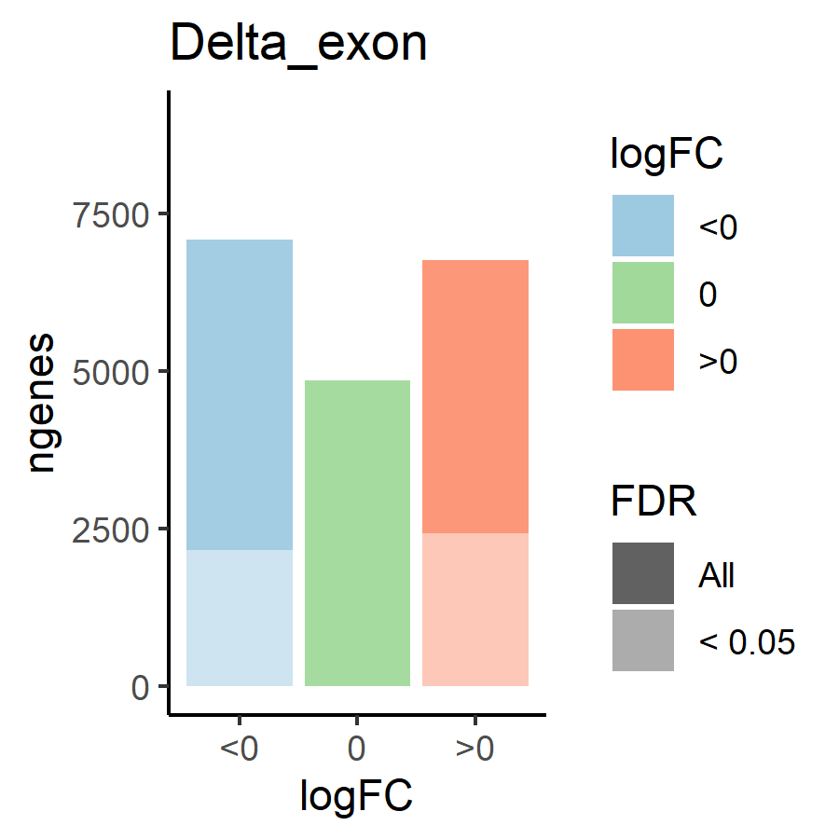
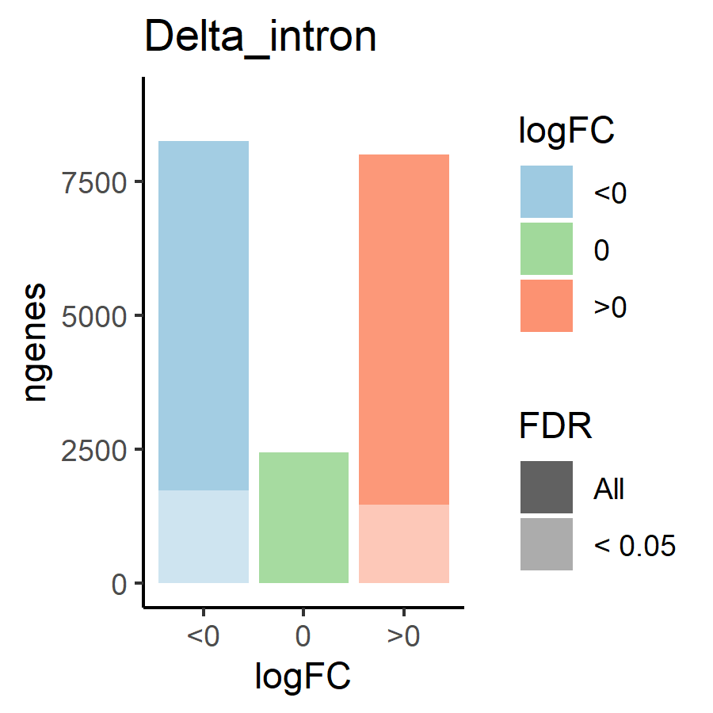
Differential expression: Δ exon and Δ intron
 |  | Δ exon (steady state mRNA) |  | Δ intron (nascent transcription)
 |  |  | FDR < 0.05 |  | FDR < 0.05
Genes included |  | 18693 | 4602 | 18693 | 3205
Corr | A v B | 0.902 | 0.958 | 0.816 | 0.929
 | A v C | 0.935 | 0.981 | 0.856 | 0.953
 | B v C | 0.904 | 0.960 | 0.814 | 0.940
Δ | > 0 | 6754 | 2436 | 8004 | 1465
Δ intron < 0 | < 0 | 7086 | 2166 | 8252 | 1740
Δ intron = 0 | = 0 | 4853 | 0 | 2437 | 0
 | Mean | -0.1403 | -0.0929 | -0.1737 | -0.2255
Correlation: Δ exon stronger than Δ intron
SITA or no SITA
If we only consider significant genes (FDR < 0.05): more exons are upregulated (2436) than downregulated (2166), but more introns are downregulated (1740) than upregulated (1465)
If we include genes with FDR > 0.05: more exons are downregulated (7086) than upregulated (6754), and more introns are downregulated (8252) than upregulated (8004)
But the difference is quite small, so I would say no SITA
HOWEVER
Mean of both Δ exon and Δ intron < 0 means that even though the number of downregulated genes is smaller, the magnitude of downregulation is larger than upregulation, ie. a smaller number of genes are strongly downregulated vs a large number of genes are weakly upregulated

Slide 18
Transcriptional or post-transcriptional regulation (Δ exon/Δ intron)
 |  | Δ exon / Δ intron
 |  | Upregulated genes (Δ exon > 0) |  |  | Downregulated genes (Δ exon < 0)
 |  | Total | FDR < 0.05 | FDR > 0.05 | Total | FDR < 0.05 | FDR > 0.05
 |  |  | Post-transcriptional | Transcriptional |  | Post-transcriptional | Transcriptional
Genes included |  | 2436 | 200 | 2236 | 2166 | 190 | 1976
Corr | A v B | 0.833 | 0.953 |  | 0.665 | 0.883
 | A v C | 0.833 | 0.968 |  | 0.720 | 0.915
 | B v C | 0.808 | 0.955 |  | 0.677 | 0.911
Δ | > 0 | 1135 | 98 |  | 848 | 77
Δ intron < 0 | < 0 | 1301 | 102 |  | 1318 | 113
Δ intron = 0 | = 0 | 0 | 0 |  | 0 | 0
 | Mean | 0.300 | 0.342 |  | -0.115 | -0.112
Changes in expression seems to be driven by nascent transcription more than post-transcription

Slide 19
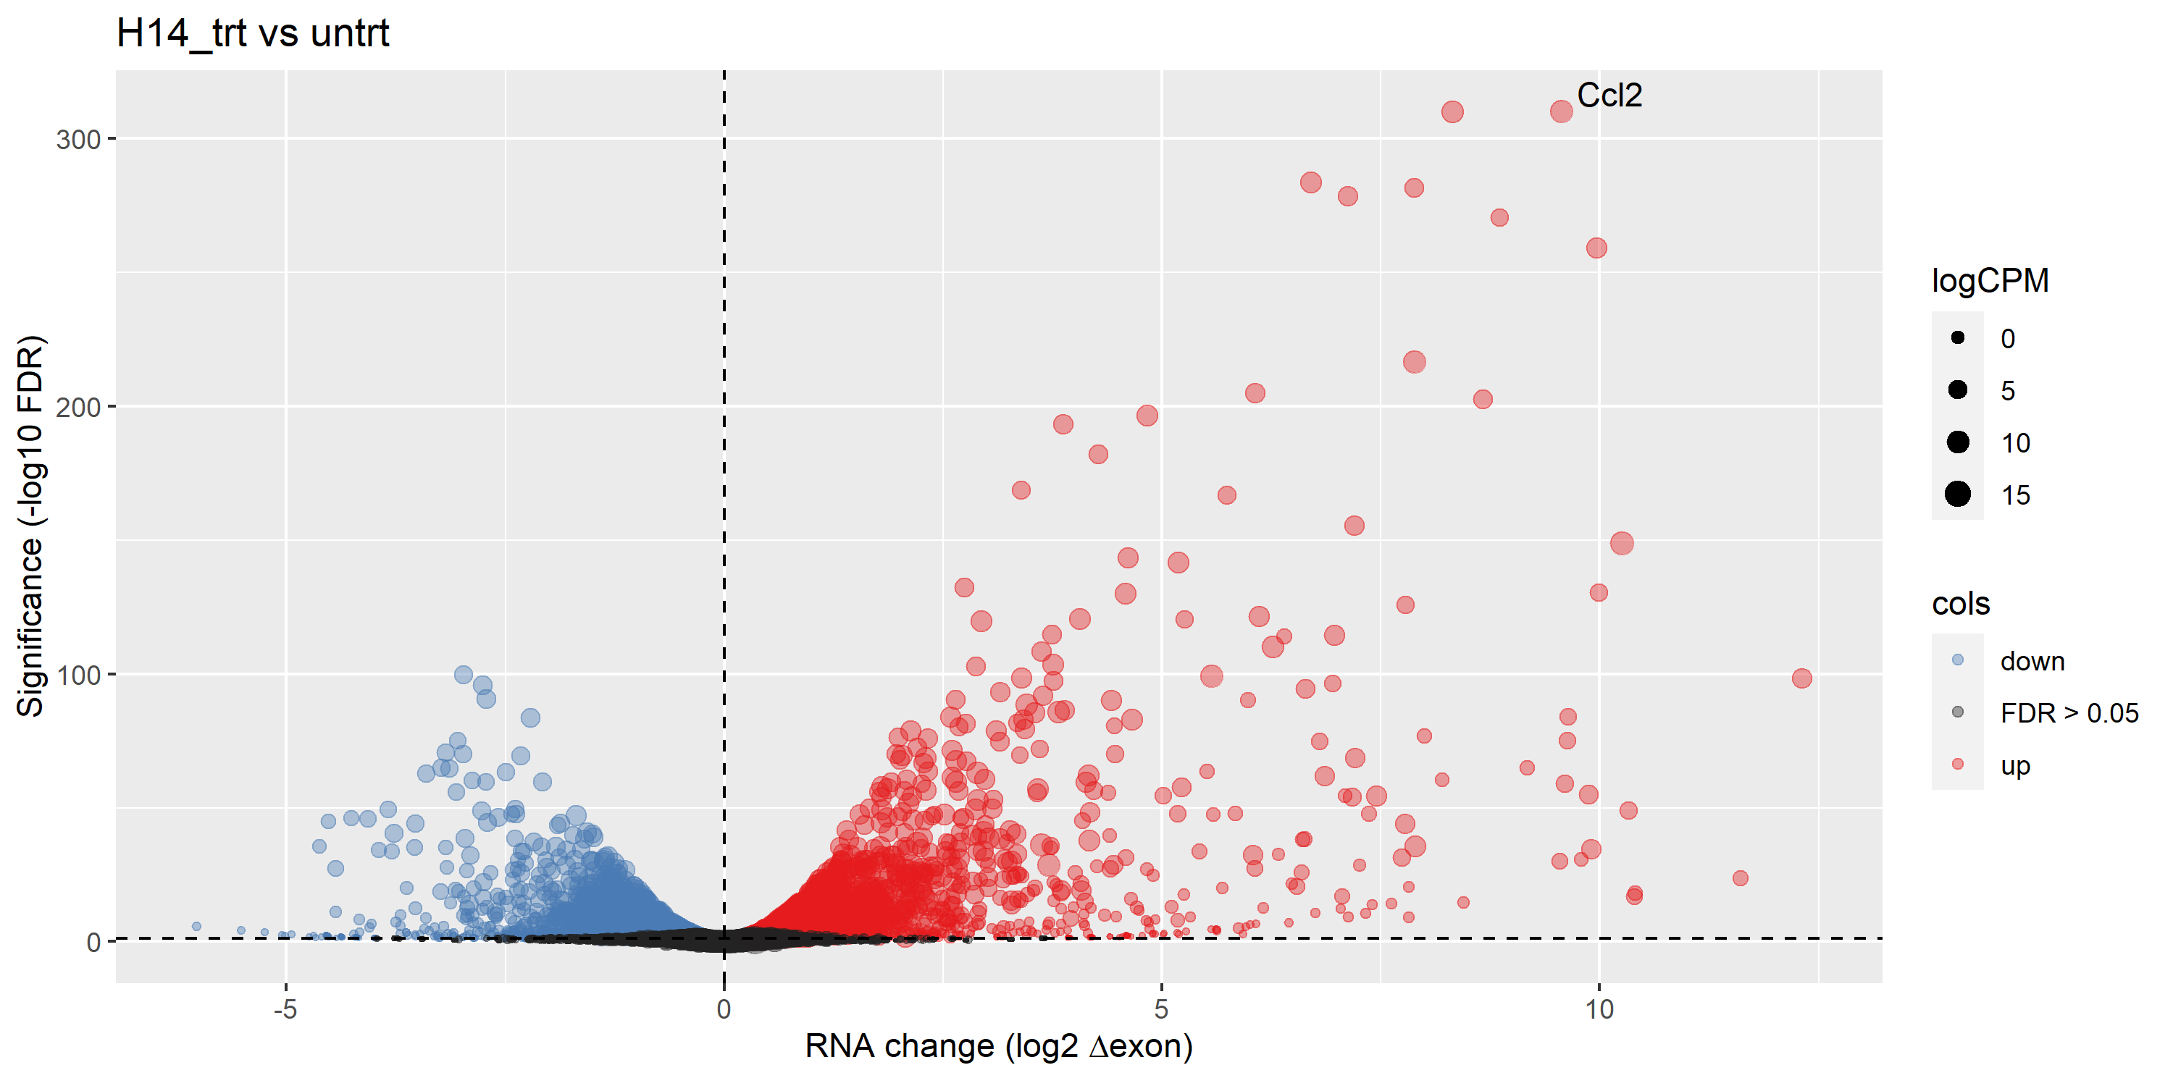
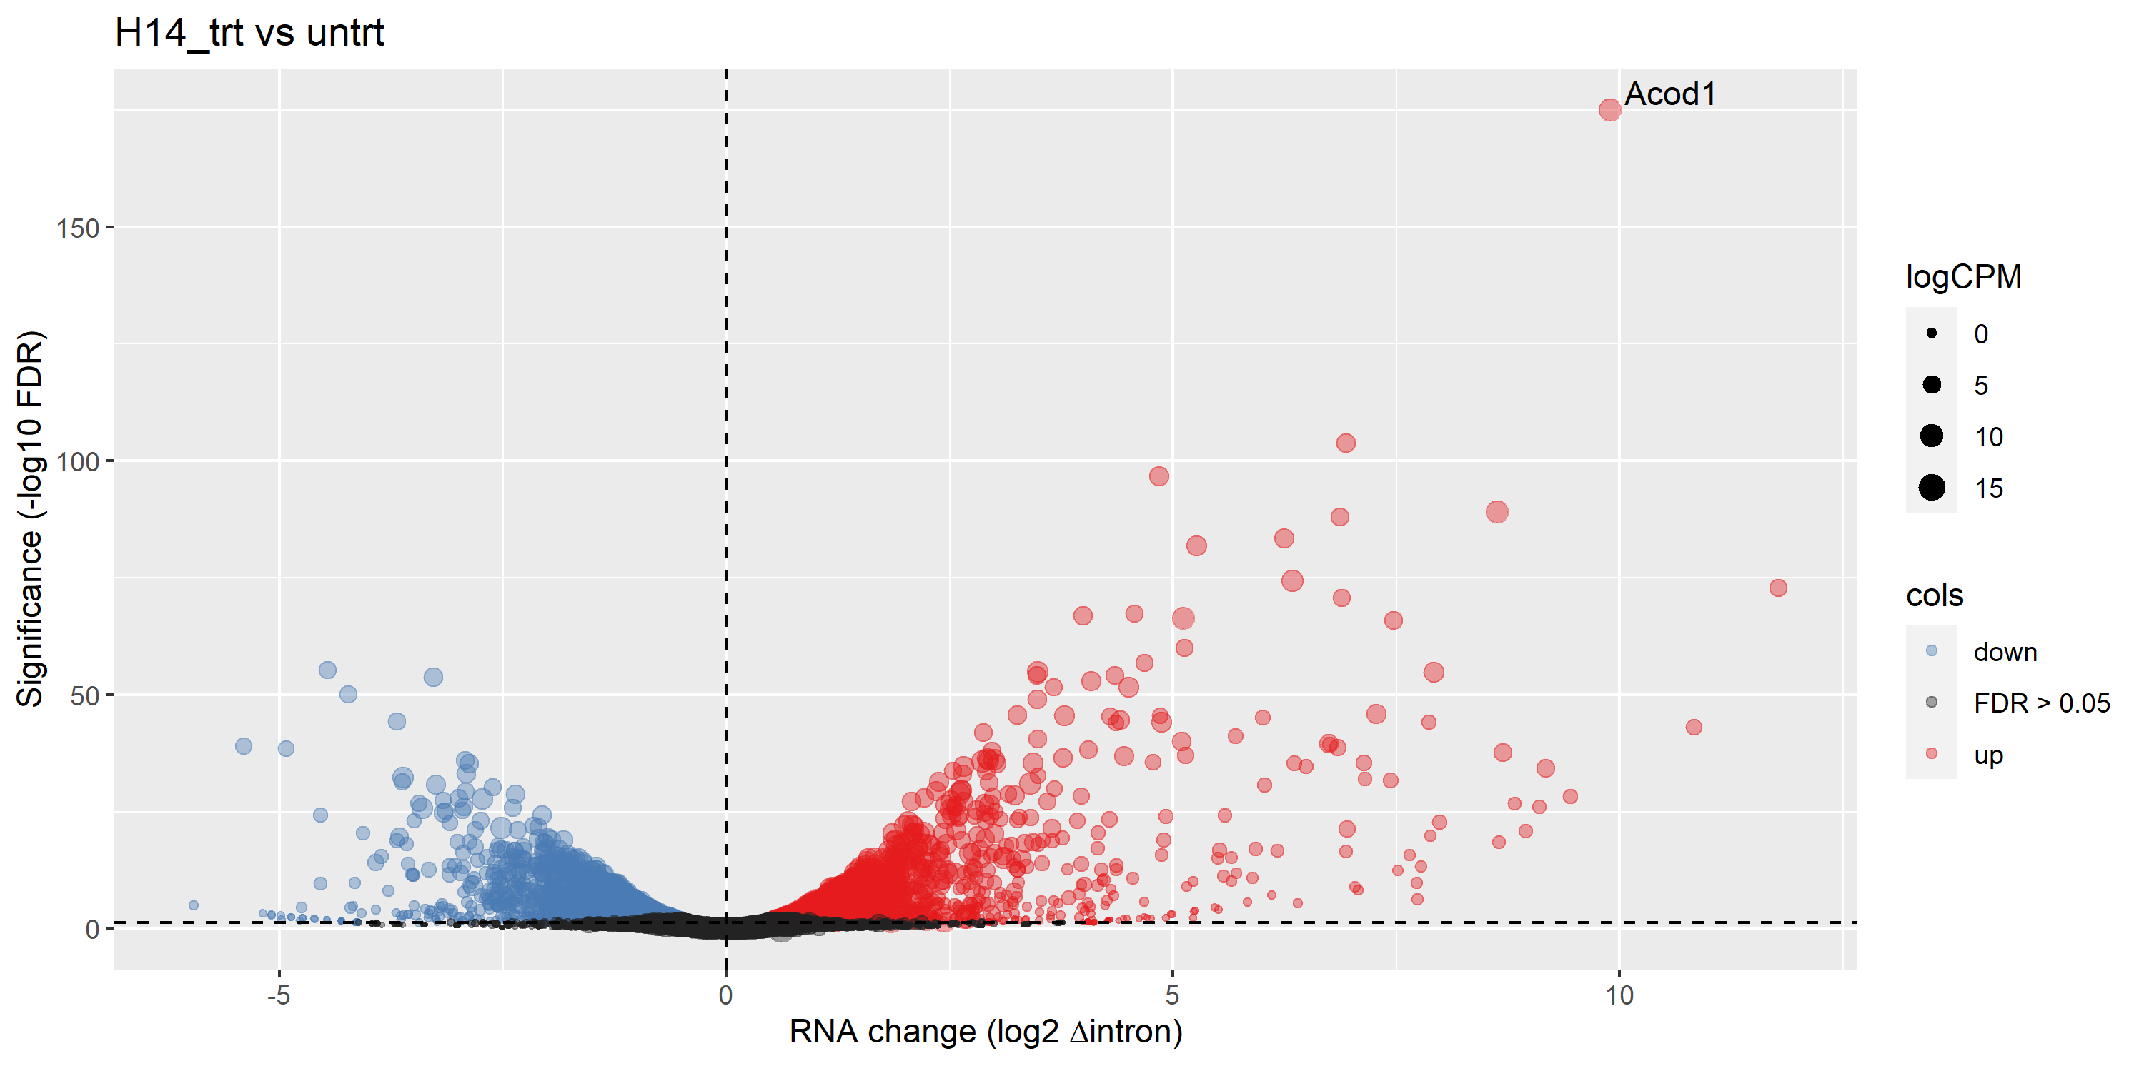
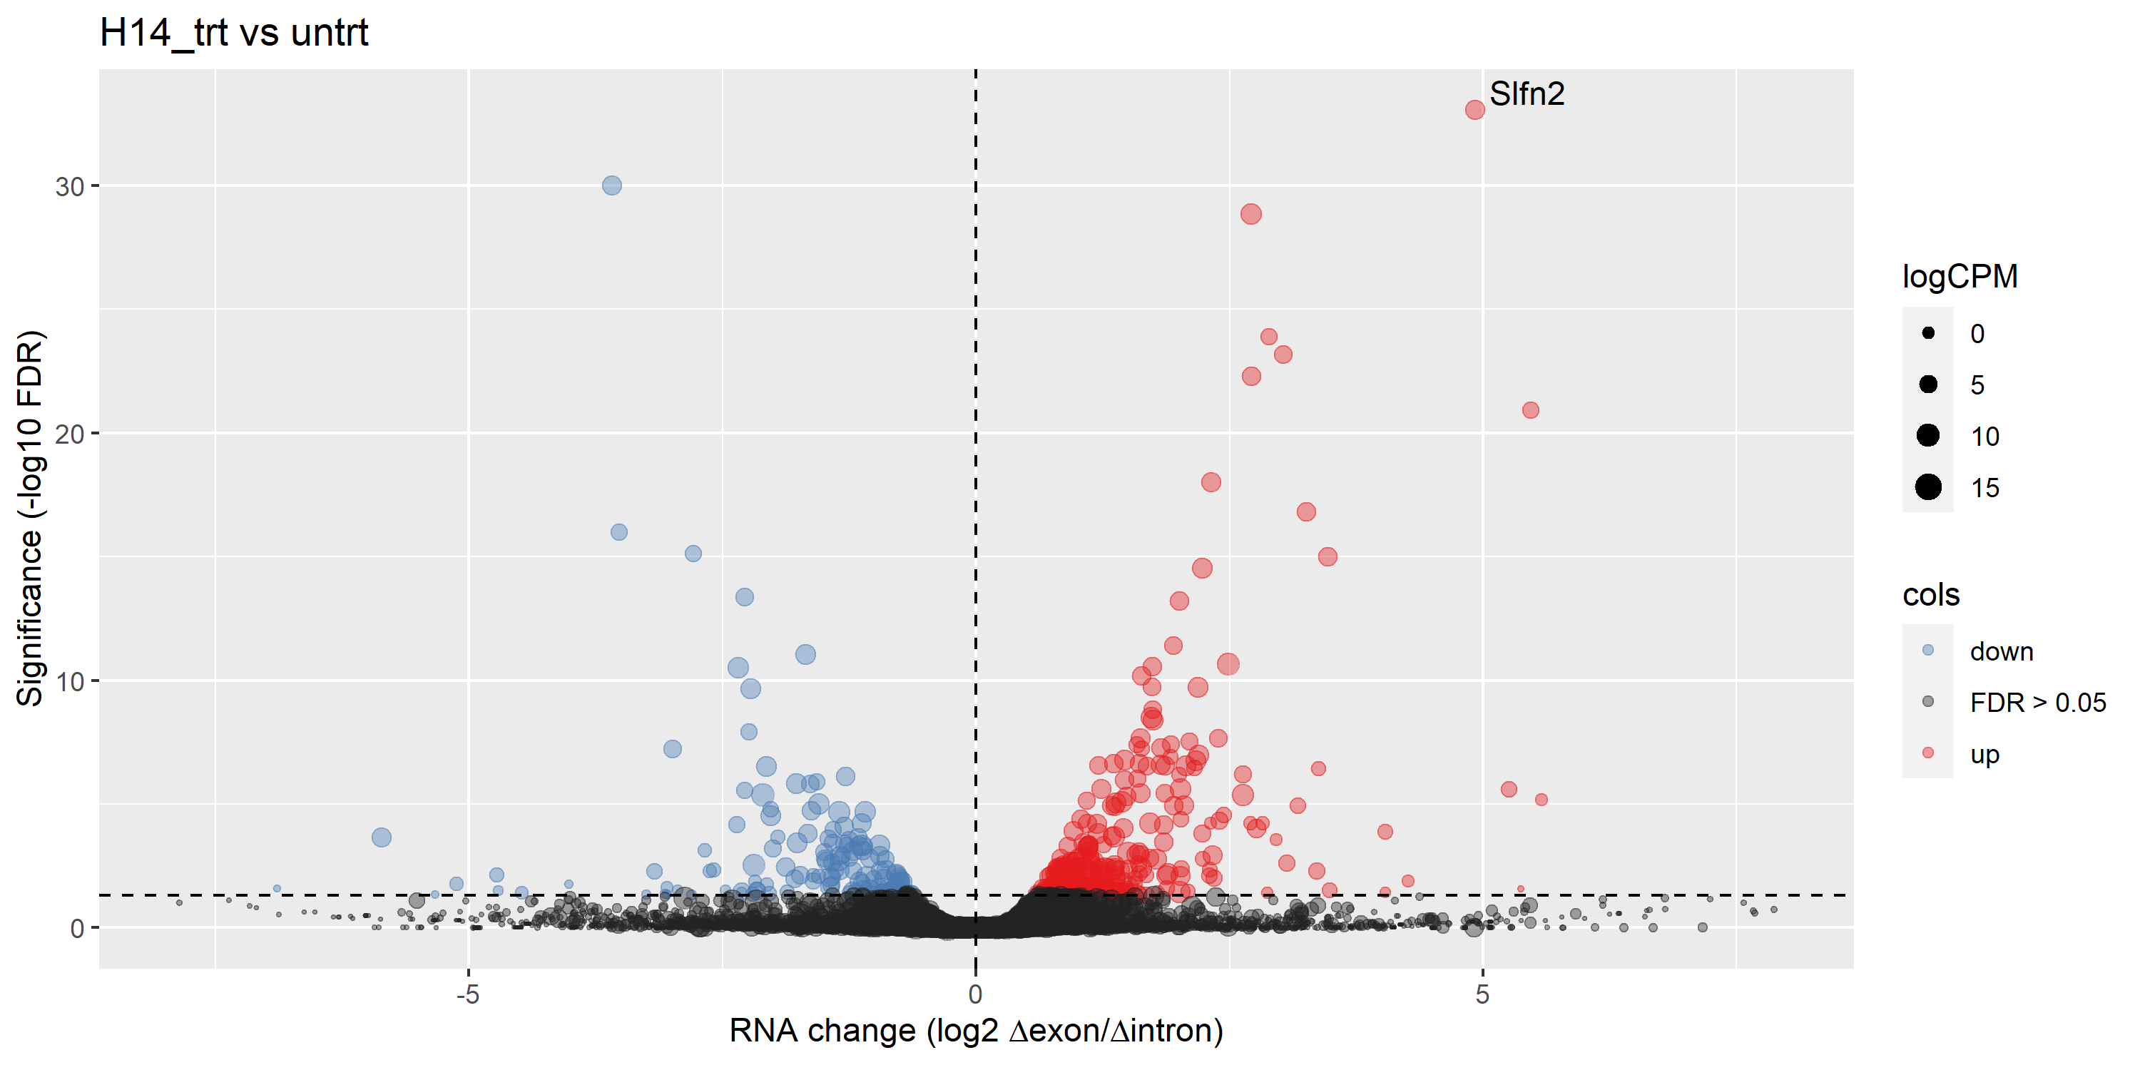
Volcano plots – no label
Exon
Up | 2436
Down | 2166
Intron
Up | 1465
Down | 1740
Differentially expressed exons and introns
- More significant red than blue -> no SITA
<- Differentially expressed exons/introns (post-transcriptionally regulated)

Slide 20
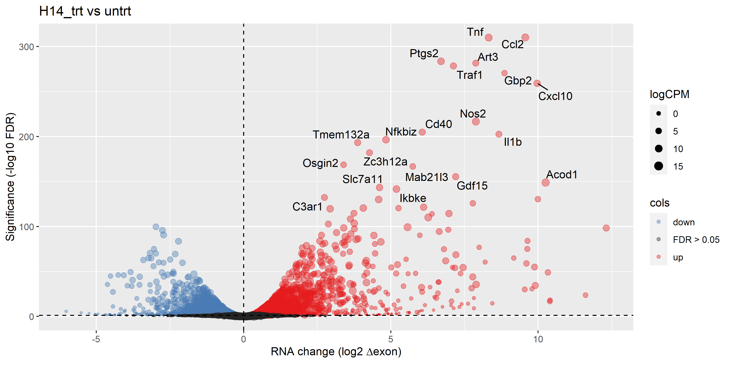
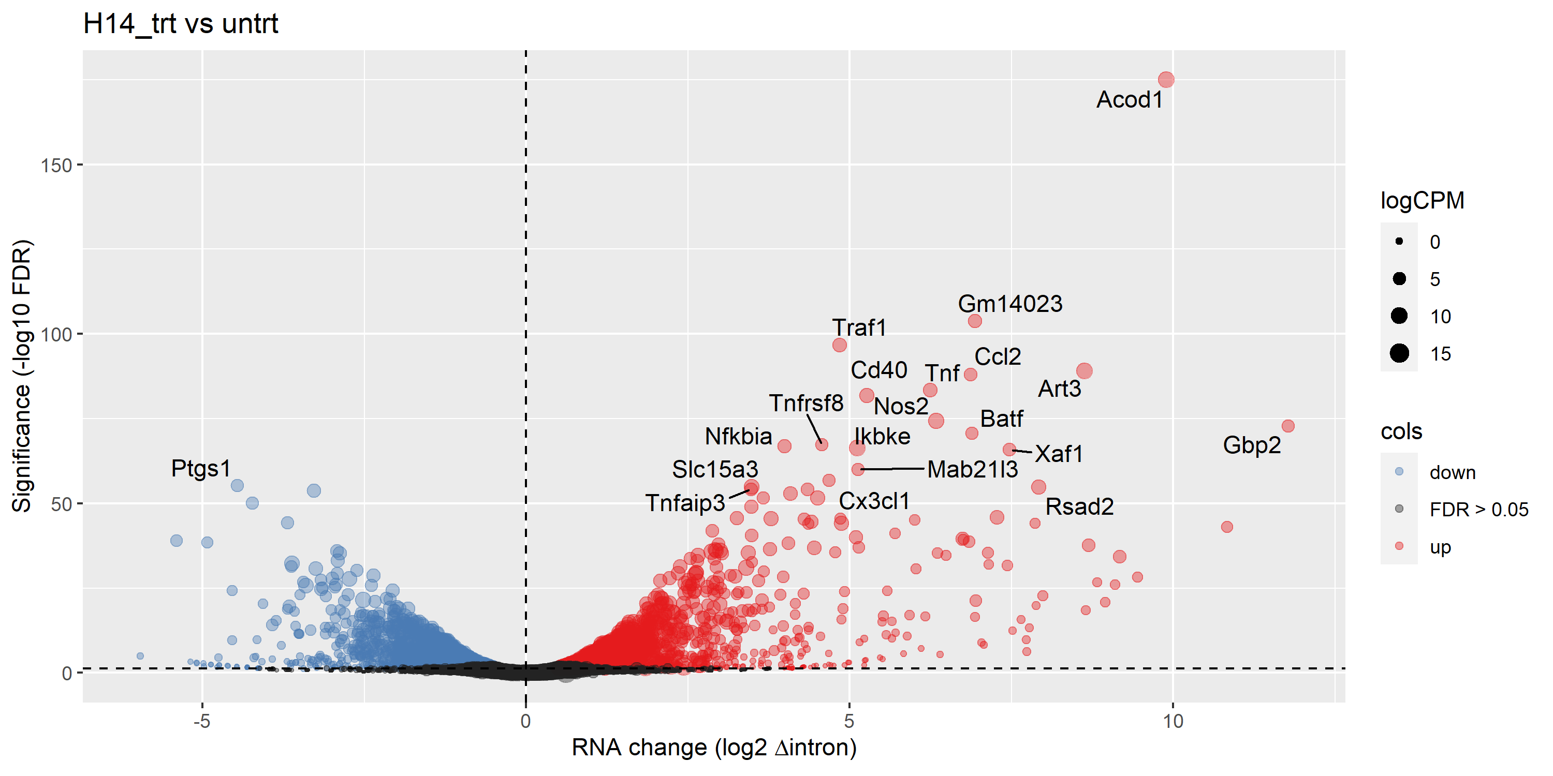
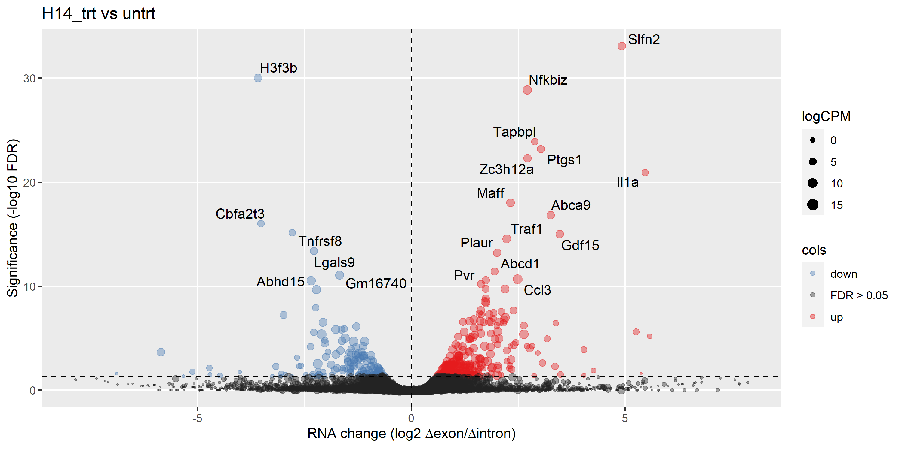
Volcano plots – top 20 genes labelled

Slide 21
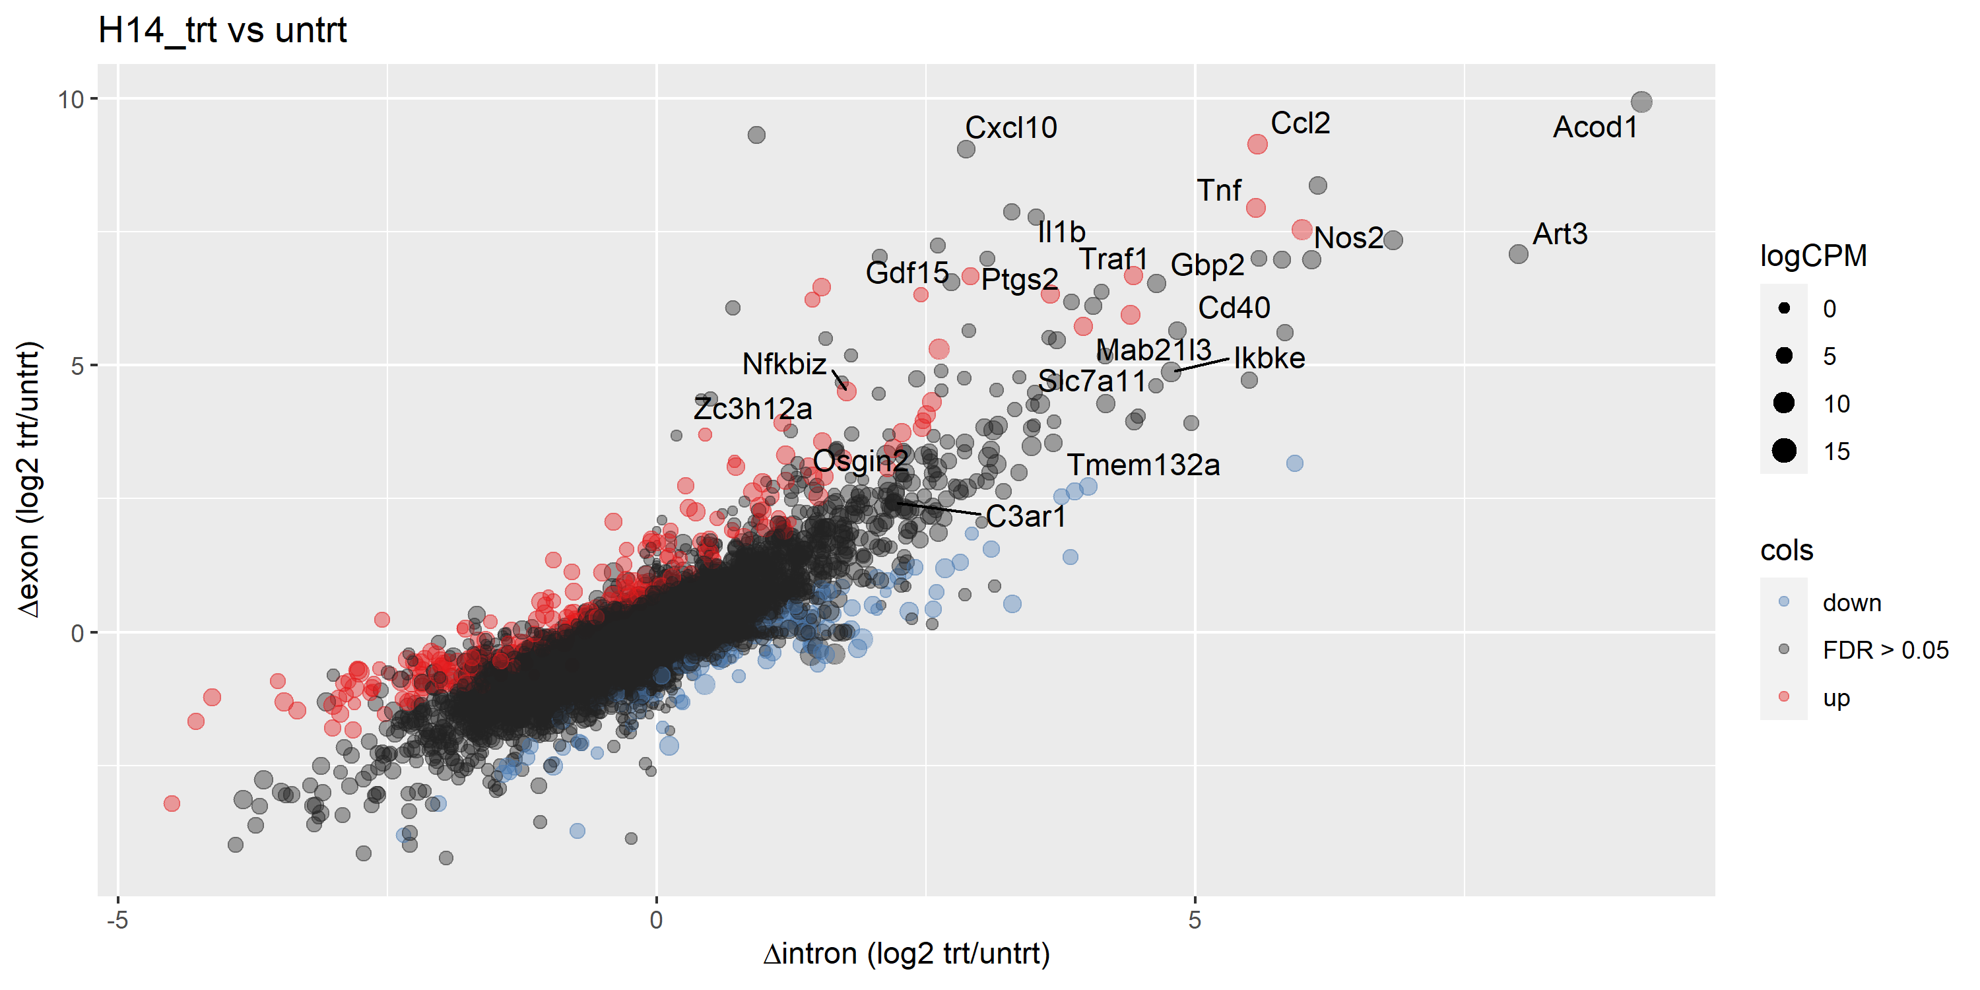
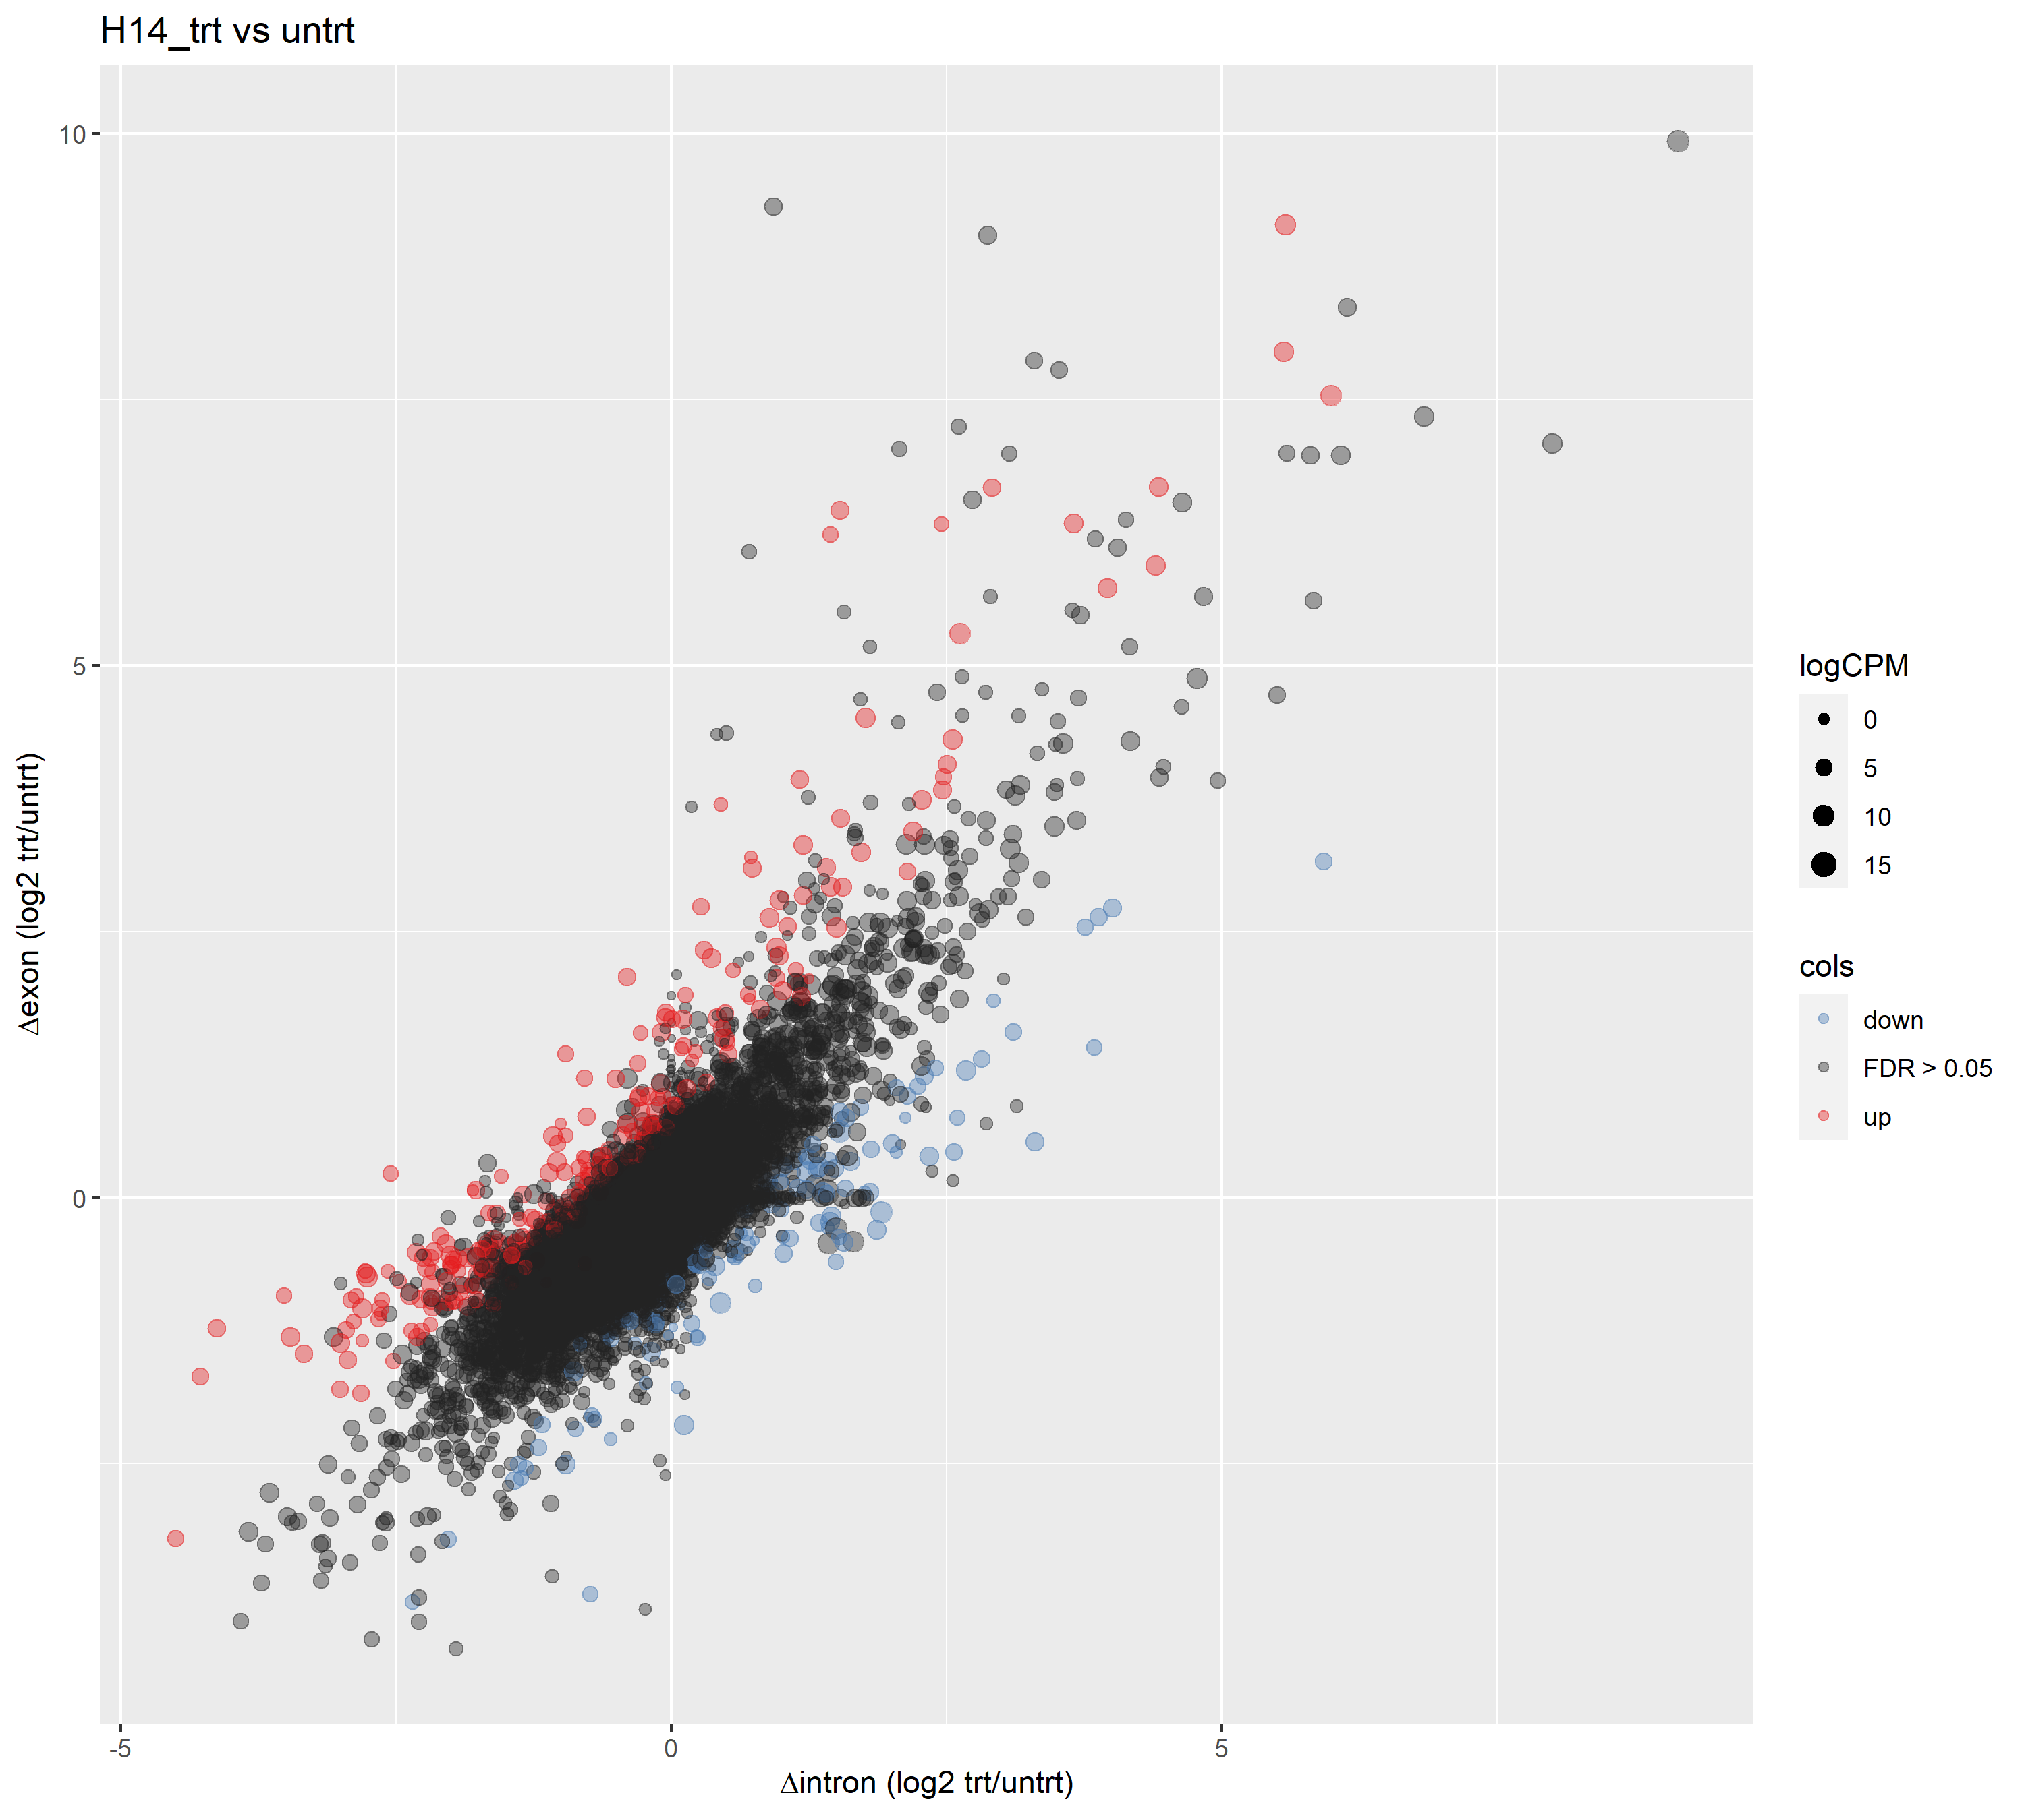
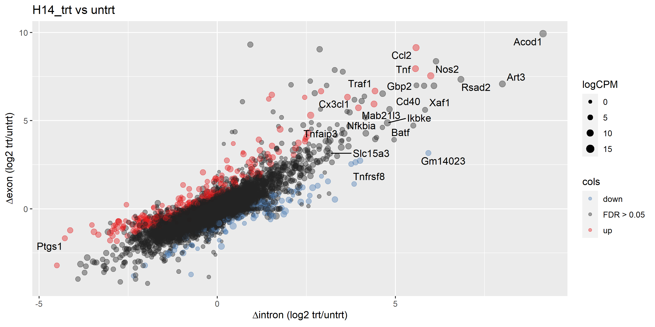
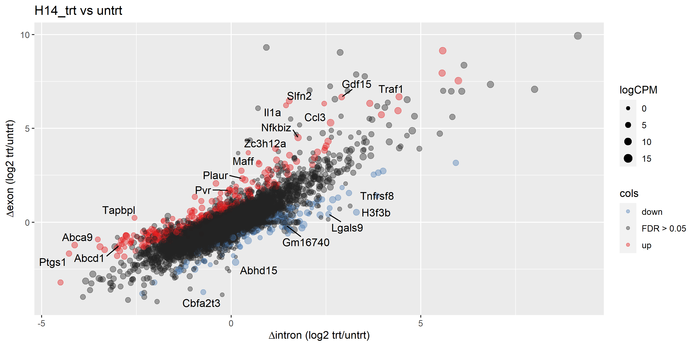
Δ exon / Δ intron plots
Top 20 differentially expressed exons
R = 0.80641
p value < 2.2e-16
Top 20 differentially expressed introns
Top 20 most likely post-transcriptionally regulated genes
Pearson coefficient close to 1: changes in expression are largely due to changes in nascent transcription rather than post-transcriptional modifications
Genes that are likely to be post-translationally regulated are coloured

Slide 22
untrt: H14 vs WT

Slide 23
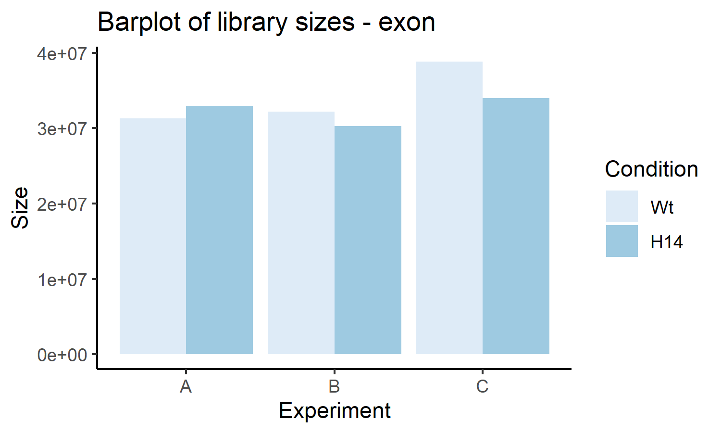
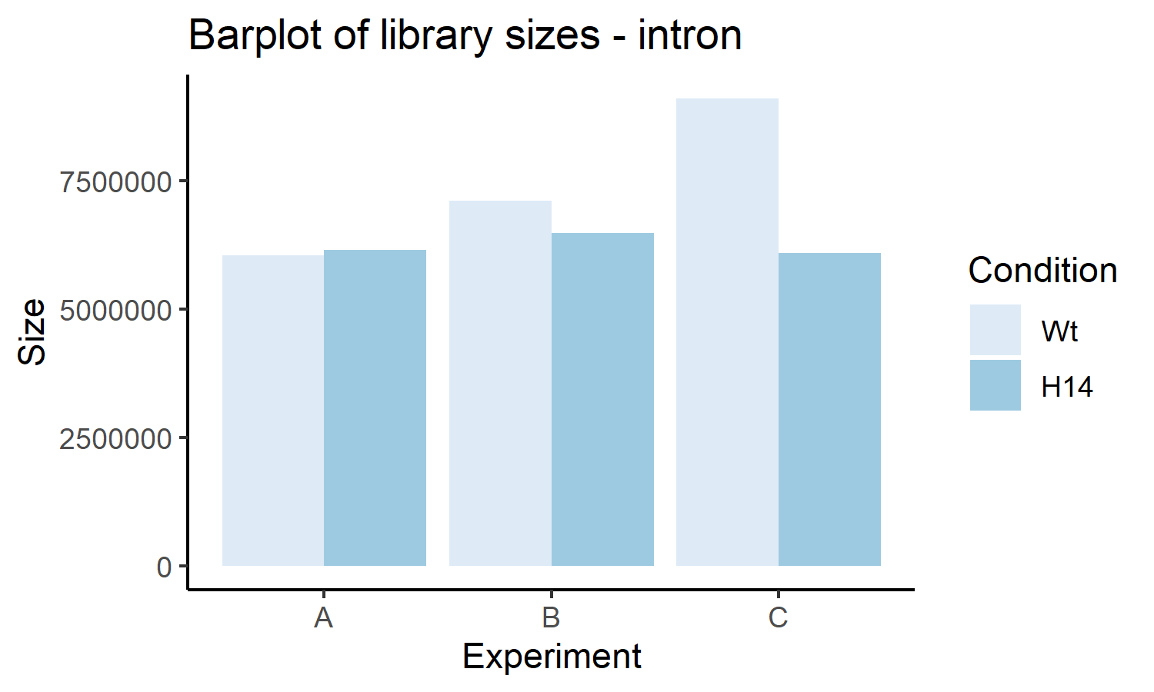
Sample details
Sample description
 | Filename | Cell | LPS | Expt
Sample 1 | WT_S1 | WT | No | A
Sample 2 | WT_S2 | WT | No | B
Sample 3 | WT_S3 | WT | No | C
Sample 10 | H14_S10 | H14 | No | A
Sample 11 | H14_S11 | H14 | No | B
Sample 12 | H14_S12 | H14 | No | C
Total count |  | Δ exon, Δ intron
 | Interpretation | A |  | B |  | C
 |  | Sample 1 | Sample 10 | Sample 2 | Sample 11 | Sample 3 | Sample 12
Total exons | Steady state mRNA | 31317398 | 32958821 | 32163255 | 30279470 | 38850126 | 33972536
Total introns | Nascent transcription | 6041266 | 6158129 | 7110487 | 6477220 | 9104240 | 6085947
Fraction of introns | Checks to make sure things are within normal ranges | 0.1617 | 0.1574 | 0.1810 | 0.1762 | 0.1899 | 0.1519
Summary |  | Min | 1st quartile | Median | Mean | 3rd quartile | Max
 |  | 0.1519 | 0.1585 | 0.1690 | 0.1697 | 0.1798 | 0.1899

Slide 24
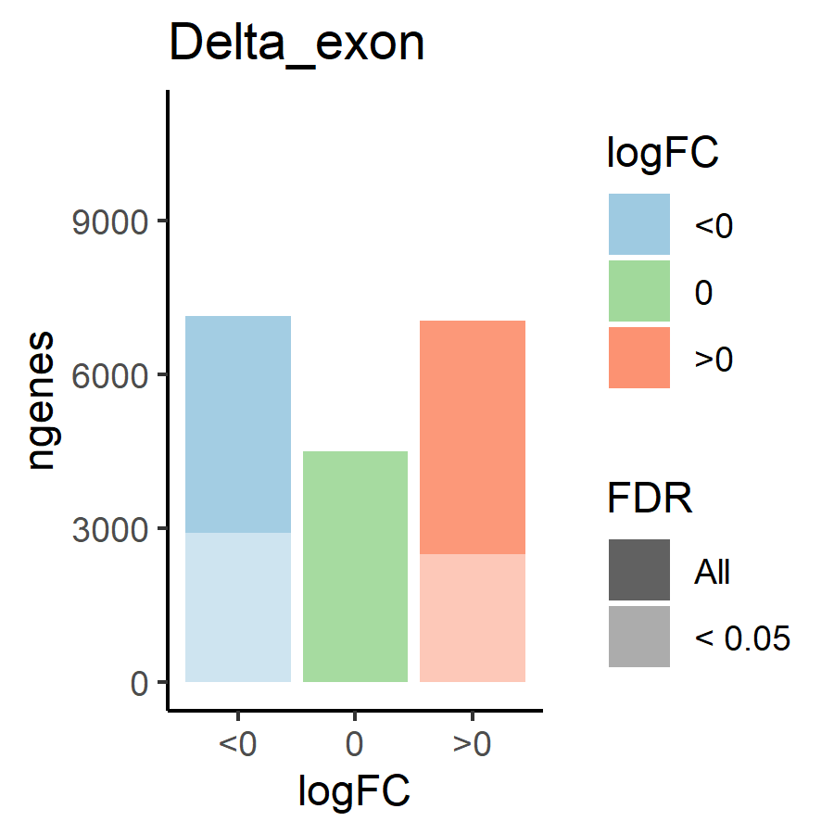
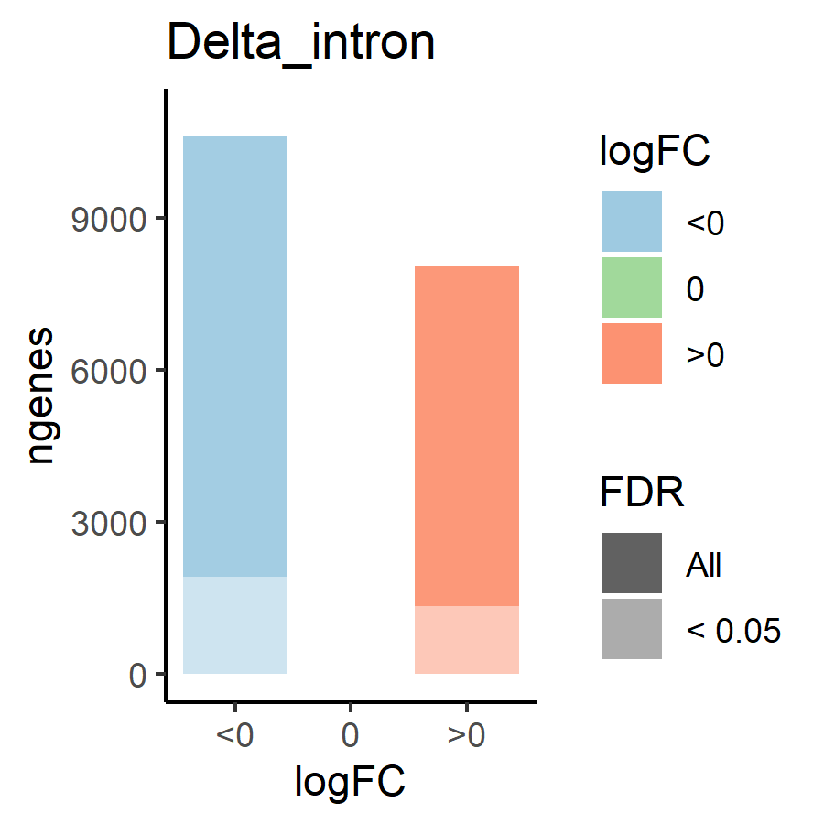
Differential expression: Δ exon and Δ intron
 |  | Δ exon (steady state mRNA) |  | Δ intron (nascent transcription)
 |  |  | FDR < 0.05 |  | FDR < 0.05
Genes included |  | 18693 | 5413 | 18693 | 3271
Corr | A v B | 0.861 | 0.944 | 0.608 | 0.870
 | A v C | 0.890 | 0.956 | 0.713 | 0.910
 | B v C | 0.868 | 0.947 | 0.753 | 0.933
Δ | > 0 | 7054 | 2492 | 8073 | 1348
Δ intron < 0 | < 0 | 7142 | 2921 | 10620 | 1923
Δ intron = 0 | = 0 | 4497 | 0 | 0 | 0
 | Mean | -0.0513 | -0.1862 | -0.0719 | -0.270
Correlation: Δ exon stronger than Δ intron
SITA or no SITA – not applicable since we are comparing KO vs WT
If we only consider significant genes (FDR < 0.05): more exons are downregulated (2921) than upregulated (2492), and more introns are downregulated (1923) than upregulated (1348)
If we include genes with FDR > 0.05: more exons are downregulated (7142) than upregulated (7054), and more introns are downregulated (10620) than upregulated (8073)

Slide 25
Transcriptional or post-transcriptional regulation (Δ exon/Δ intron)
 |  | Δ exon / Δ intron
 |  | Upregulated genes (Δ exon > 0) |  |  | Downregulated genes (Δ exon < 0)
 |  | Total | FDR < 0.05 | FDR > 0.05 | Total | FDR < 0.05 | FDR > 0.05
 |  |  | Post-transcriptional | Transcriptional |  | Post-transcriptional | Transcriptional
Genes included |  | 2492 | 84 | 2408 | 2921 | 274 | 2647
Corr | A v B | 0.353 | 0.953 |  | 0.667 | 0.909
 | A v C | 0.498 | 0.968 |  | 0.697 | 0.902
 | B v C | 0.532 | 0.955 |  | 0.739 | 0.897
Δ | > 0 | 1658 | 70 |  | 1657 | 123
Δ intron < 0 | < 0 | 834 | 14 |  | 1264 | 151
Δ intron = 0 | = 0 | 0 | 0 |  | 0 | 0
 | Mean | 0.235 | 0.763 |  | -0.185 | -0.490
Interpret with caution

Slide 26
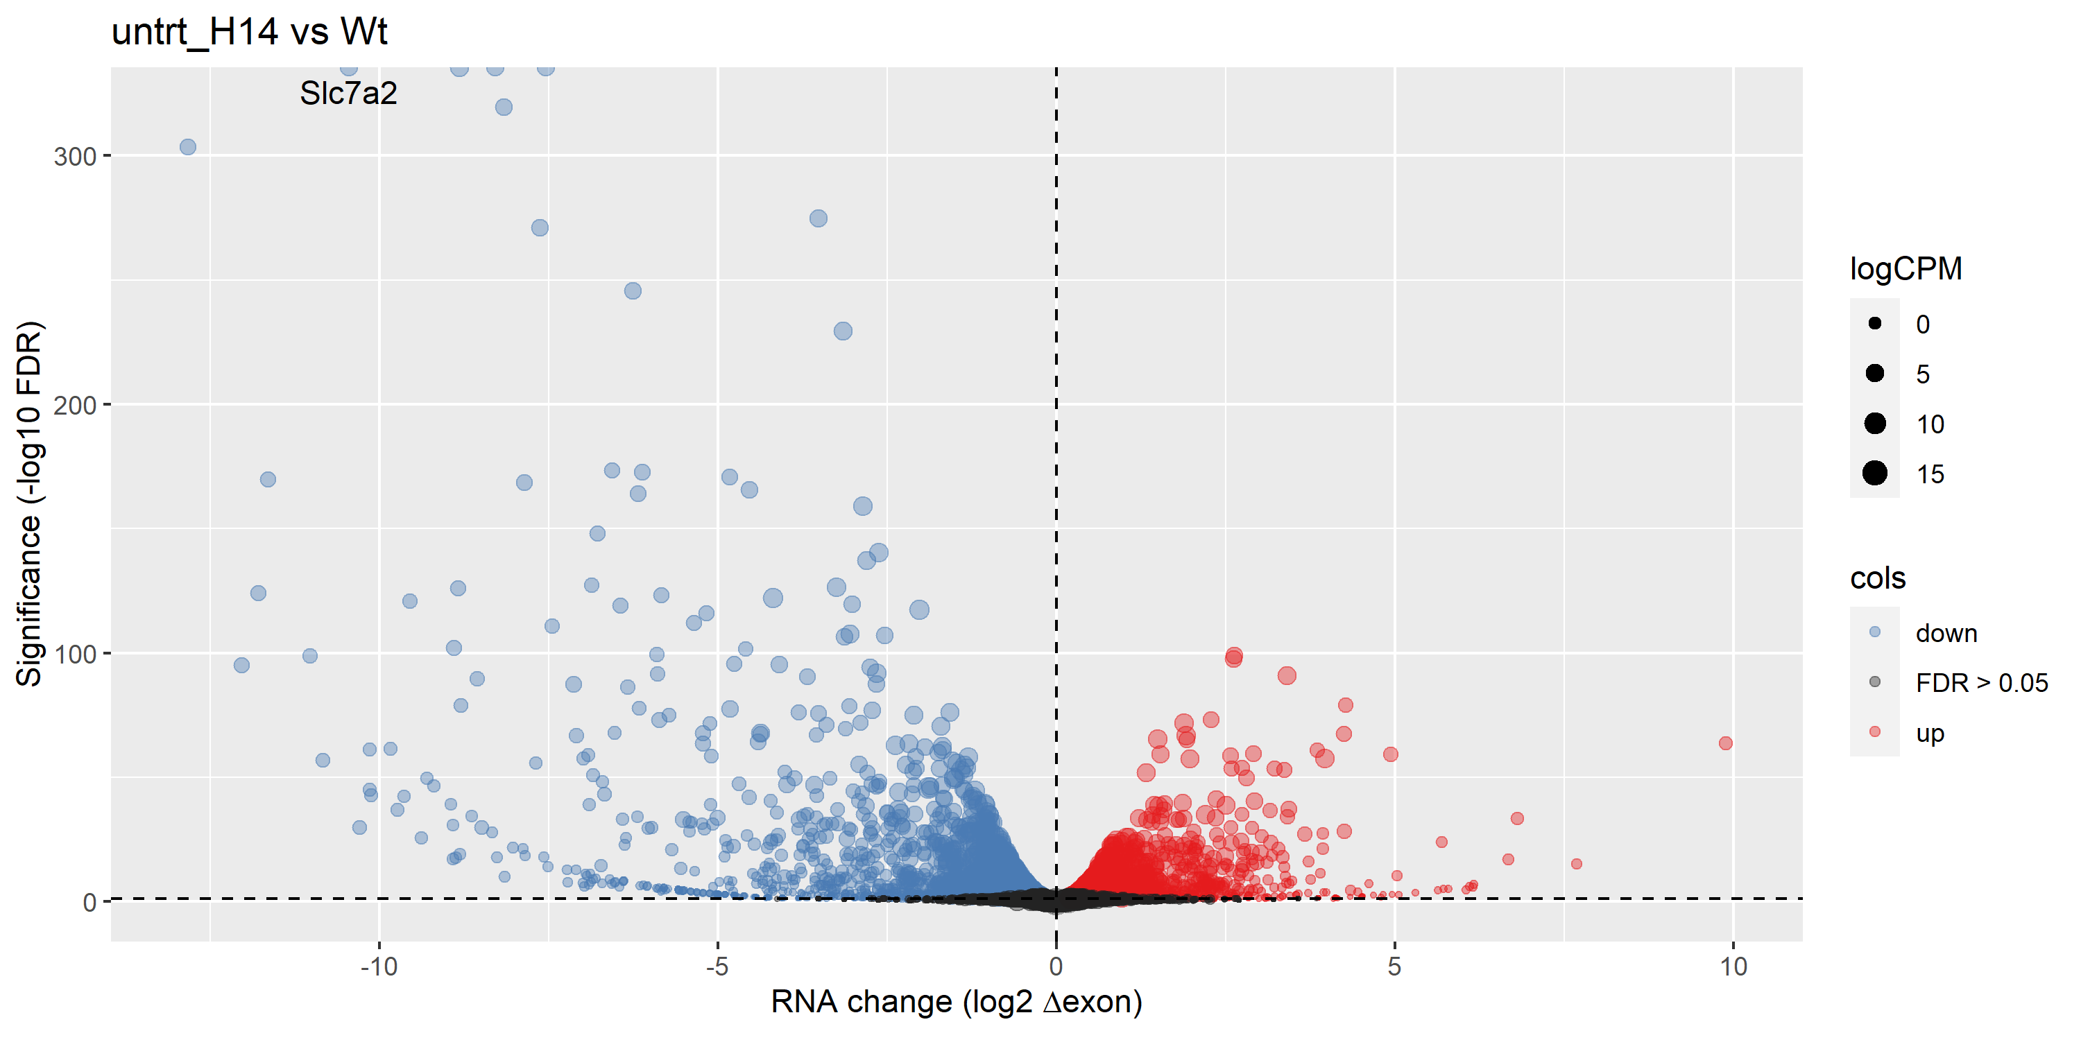
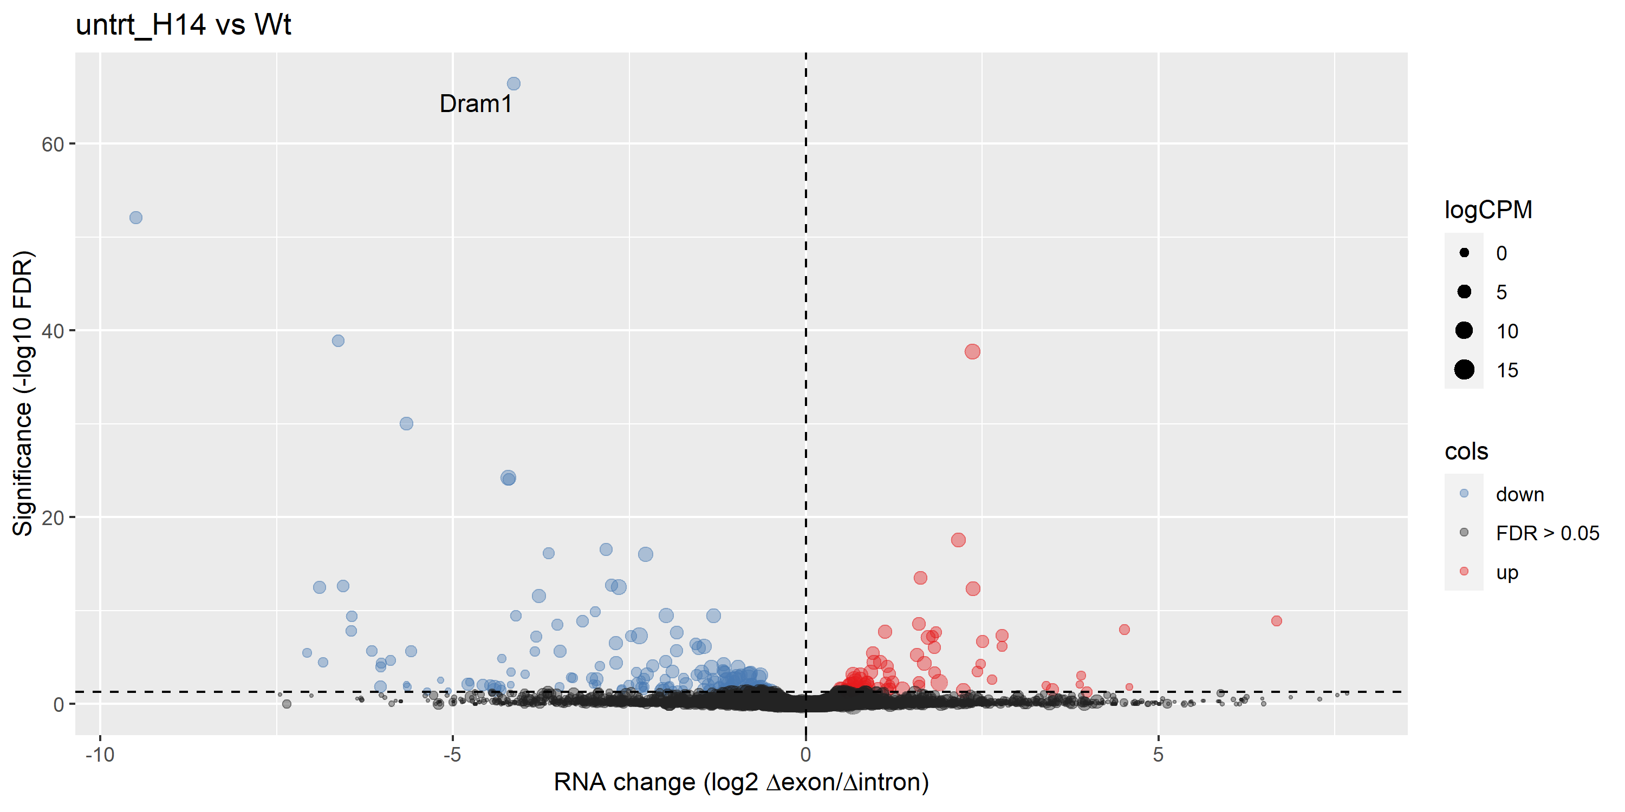
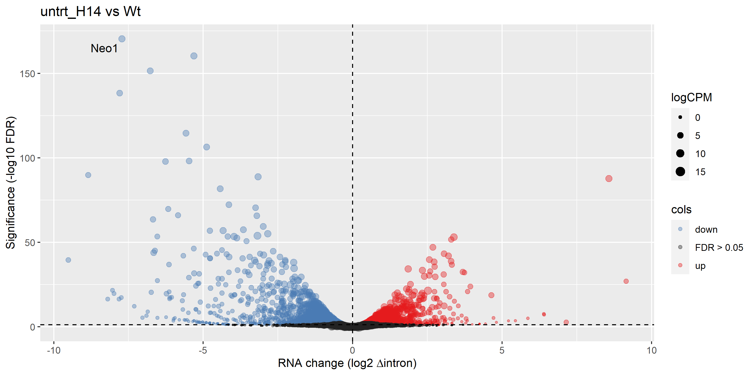
Volcano plots – no label
Exon
Up | 2492
Down | 2921
Intron
Up | 1348
Down | 1923
<- Differentially expressed exons/introns (post-transcriptionally regulated)

Slide 27
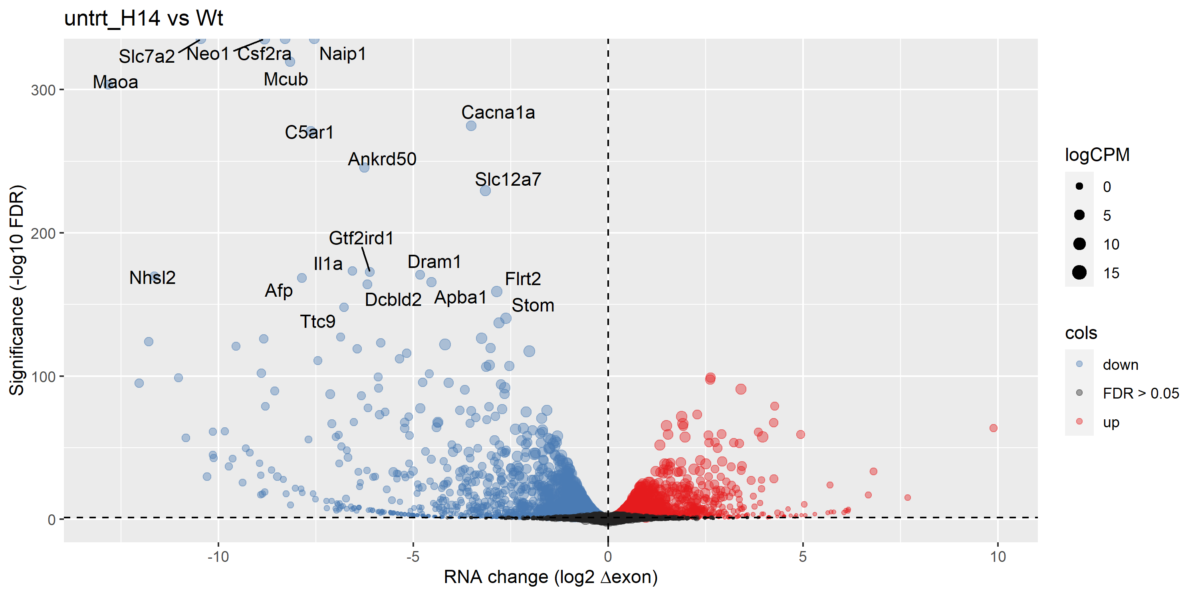
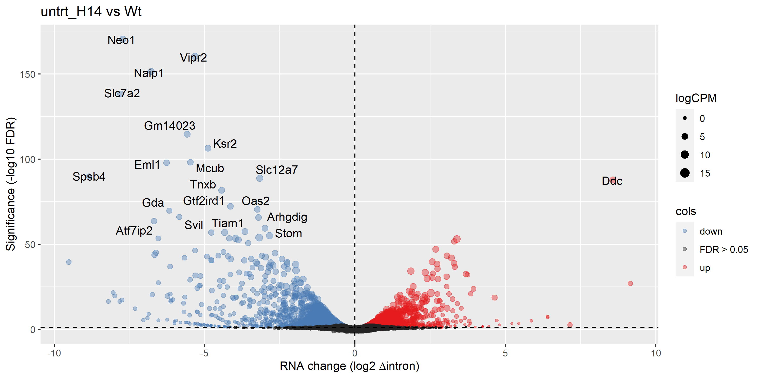
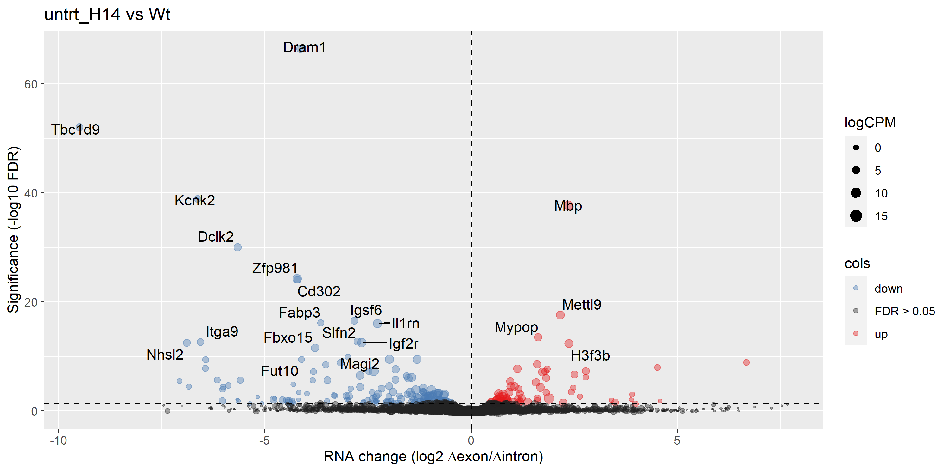
Volcano plots – top 20 genes labelled

Slide 28
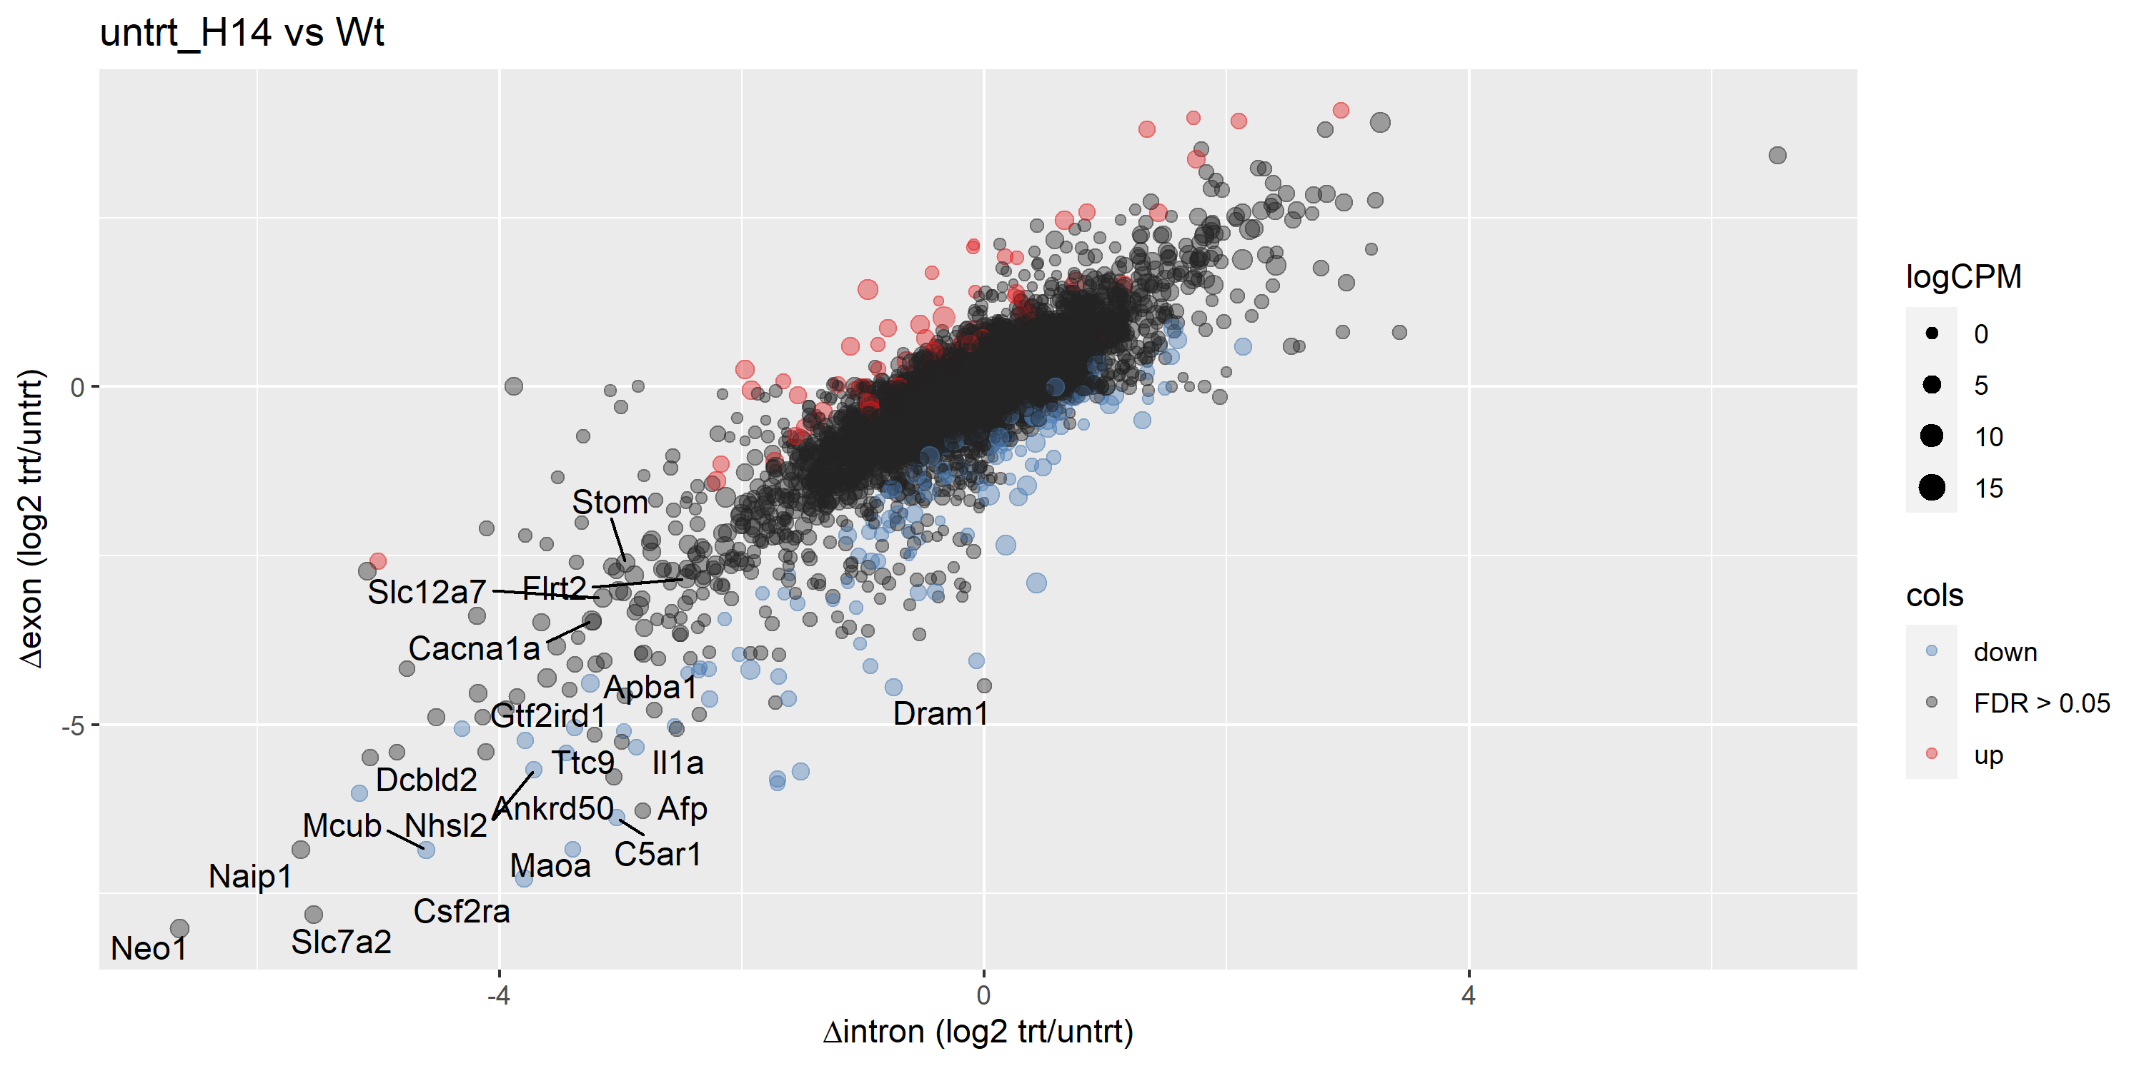
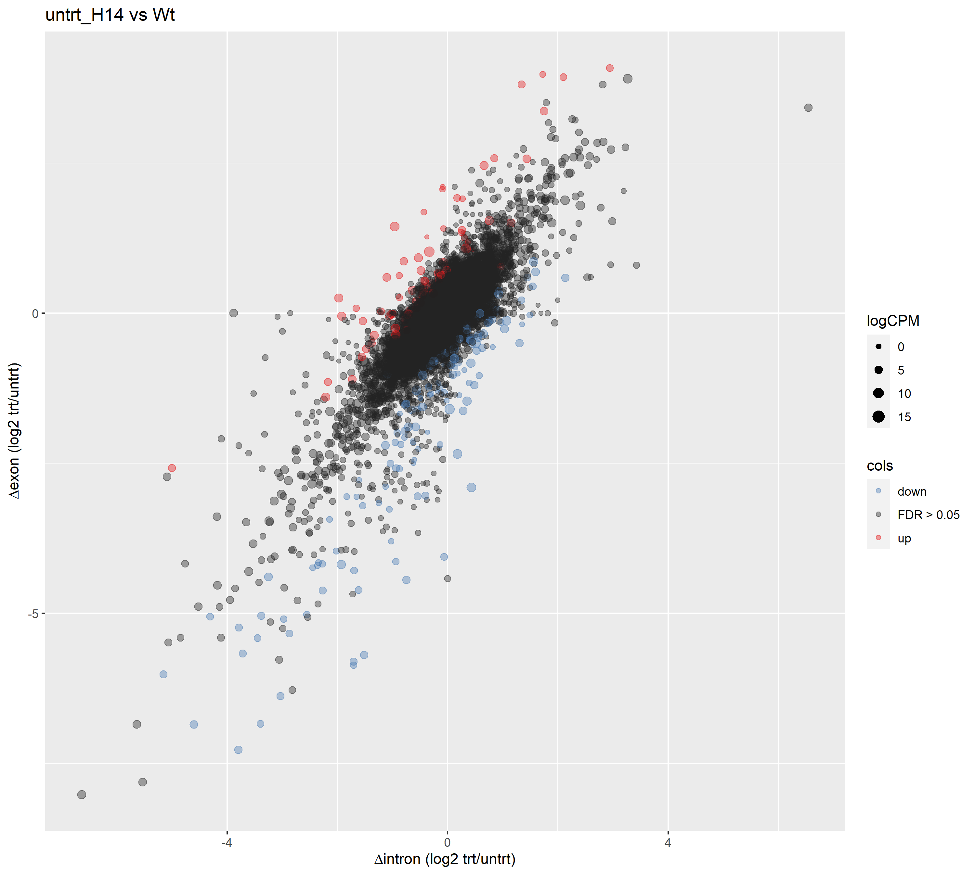

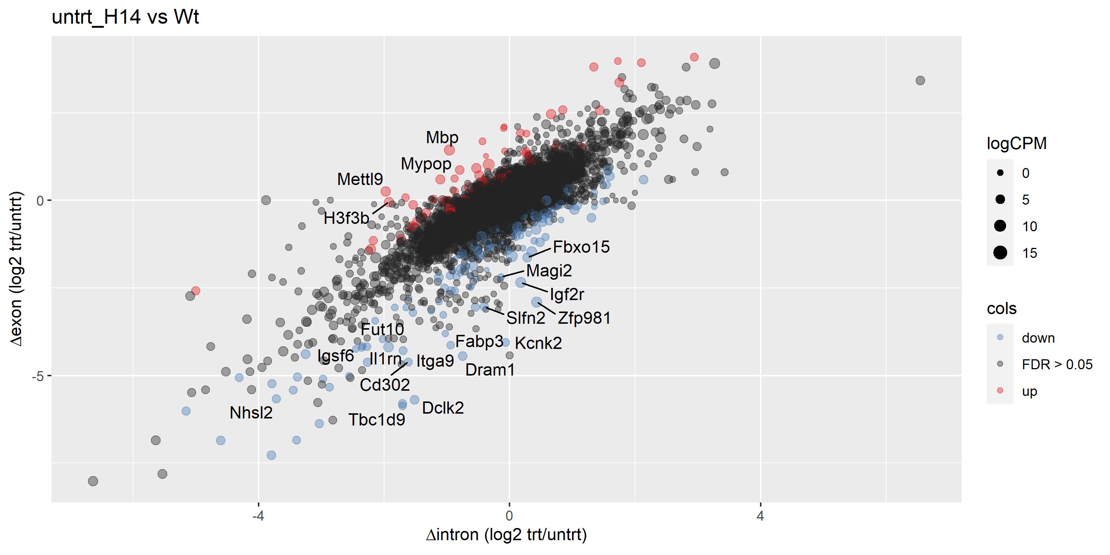
Δ exon / Δ intron plots
Top 20 differentially expressed exons
R = 0.78214
p value < 2.2e-16
Top 20 differentially expressed introns
Top 20 most likely post-transcriptionally regulated genes
Pearson coefficient close to 1: changes in expression are largely due to changes in nascent transcription rather than post-transcriptional modifications
Genes that are likely to be post-translationally regulated are coloured

Slide 29
trt: H14 vs WT

Slide 30
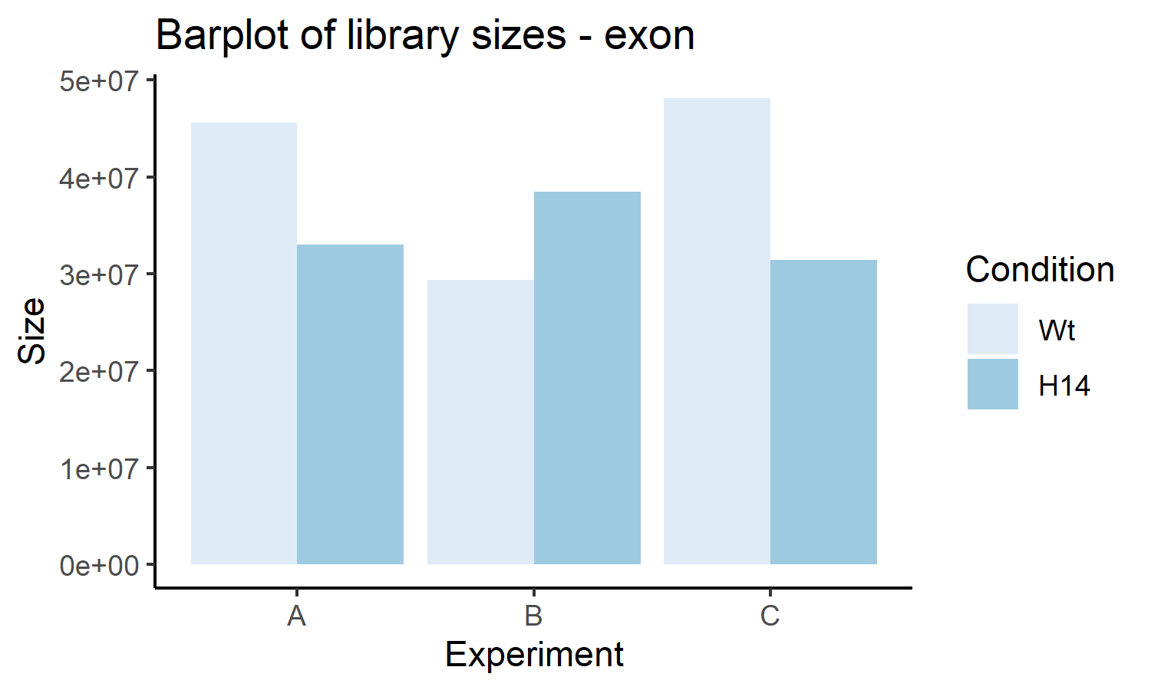
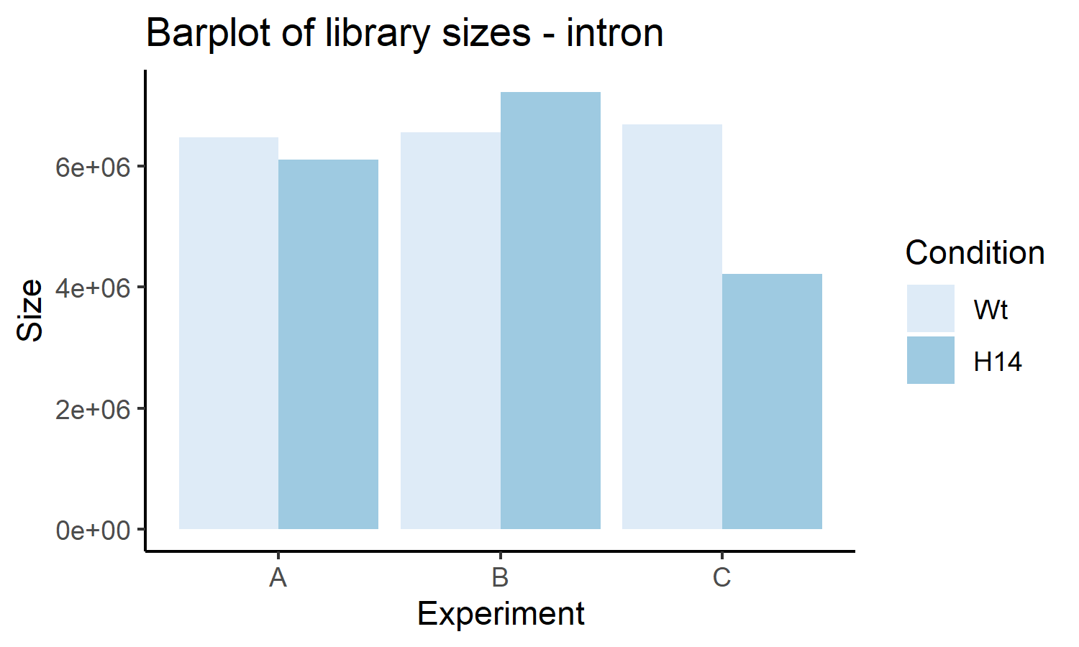
Sample details
Sample description
 | Filename | Cell | LPS | Expt
Sample 4 | WT-LPS-S4 | WT | Yes | A
Sample 5 | WT-LPS-S5 | WT | Yes | B
Sample 6 | WT-LPS-S6 | WT | Yes | C
Sample 7 | H14-LPS-S7 | H14 | Yes | A
Sample 8 | H14-LPS-S8 | H14 | Yes | B
Sample 9 | H14-LPS-S9 | H14 | Yes | C
Total count |  | Δ exon, Δ intron
 | Interpretation | A |  | B |  | C
 |  | Sample 4 | Sample 7 | Sample 5 | Sample 8 | Sample 6 | Sample 9
Total exons | Steady state mRNA | 45560209 | 32978044 | 29410141 | 38504452 | 48156533 | 31455549
Total introns | Nascent transcription | 6462774 | 6104100 | 6546633 | 7220804 | 6682582 | 4217897
Fraction of introns | Checks to make sure things are within normal ranges | 0.1242 | 0.1562 | 0.1821 | 0.1579 | 0.1219 | 0.1182
Summary |  | Min | 1st quartile | Median | Mean | 3rd quartile | Max
 |  | 0.1182 | 0.1225 | 0.1402 | 0.1434 | 0.1575 | 0.1821

Slide 31


Differential expression: Δ exon and Δ intron
 |  | Δ exon (steady state mRNA) |  | Δ intron (nascent transcription)
 |  |  | FDR < 0.05 |  | FDR < 0.05
Genes included |  | 18693 | 5154 | 18693 | 3132
Corr | A v B | 0.855 | 0.936 | 0.709 | 0.898
 | A v C | 0.916 | 0.966 | 0.773 | 0.925
 | B v C | 0.868 | 0.941 | 0.757 | 0.920
Δ | > 0 | 6836 | 2225 | 8157 | 1310
Δ intron < 0 | < 0 | 7276 | 2929 | 8207 | 1822
Δ intron = 0 | = 0 | 4581 | 0 | 2329 | 0
 | Mean | -0.0741 | -0.2843 | -0.0969 | -0.3910
Correlation: Δ exon stronger than Δ intron
SITA or no SITA – not applicable since we are comparing KO vs WT
If we only consider significant genes (FDR < 0.05): more exons are downregulated (2929) than upregulated (2225), and more introns are downregulated (1822) than upregulated (1310)
If we include genes with FDR > 0.05: more exons are downregulated (7276) than upregulated (6836), and more introns are downregulated (8207) than upregulated (8157)

Slide 32
Transcriptional or post-transcriptional regulation (Δ exon/Δ intron)
 |  | Δ exon / Δ intron
 |  | Upregulated genes (Δ exon > 0) |  |  | Downregulated genes (Δ exon < 0)
 |  | Total | FDR < 0.05 | FDR > 0.05 | Total | FDR < 0.05 | FDR > 0.05
 |  |  | Post-transcriptional | Transcriptional |  | Post-transcriptional | Transcriptional
Genes included |  | 2225 | 57 | 2168 | 2929 | 196 | 2733
Corr | A v B | 0.470 | 0.890 |  | 0.737 | 0.852
 | A v C | 0.581 | 0.937 |  | 0.776 | 0.876
 | B v C | 0.516 | 0.919 |  | 0.766 | 0.898
Δ | > 0 | 1078 | 41 |  | 1297 | 46
Δ intron < 0 | < 0 | 1147 | 16 |  | 1632 | 150
Δ intron = 0 | = 0 | 0 | 0 |  | 0 | 0
 | Mean | 0.247 | 0.782 |  | -0.230 | -0.961
Interpret with caution

Slide 33
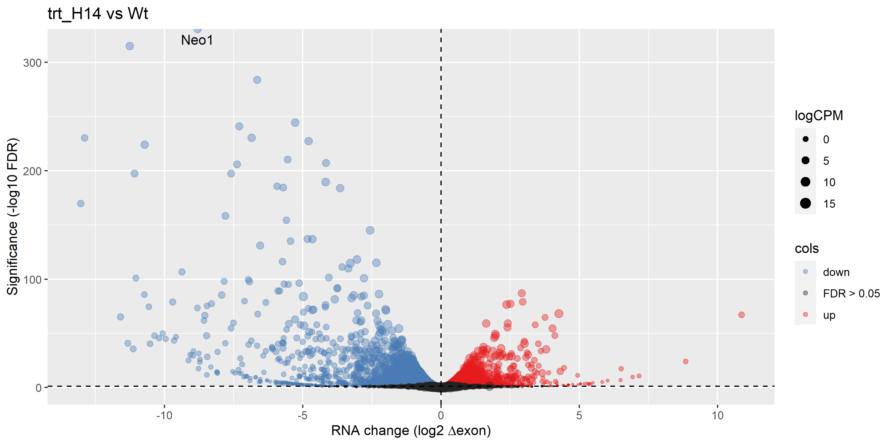
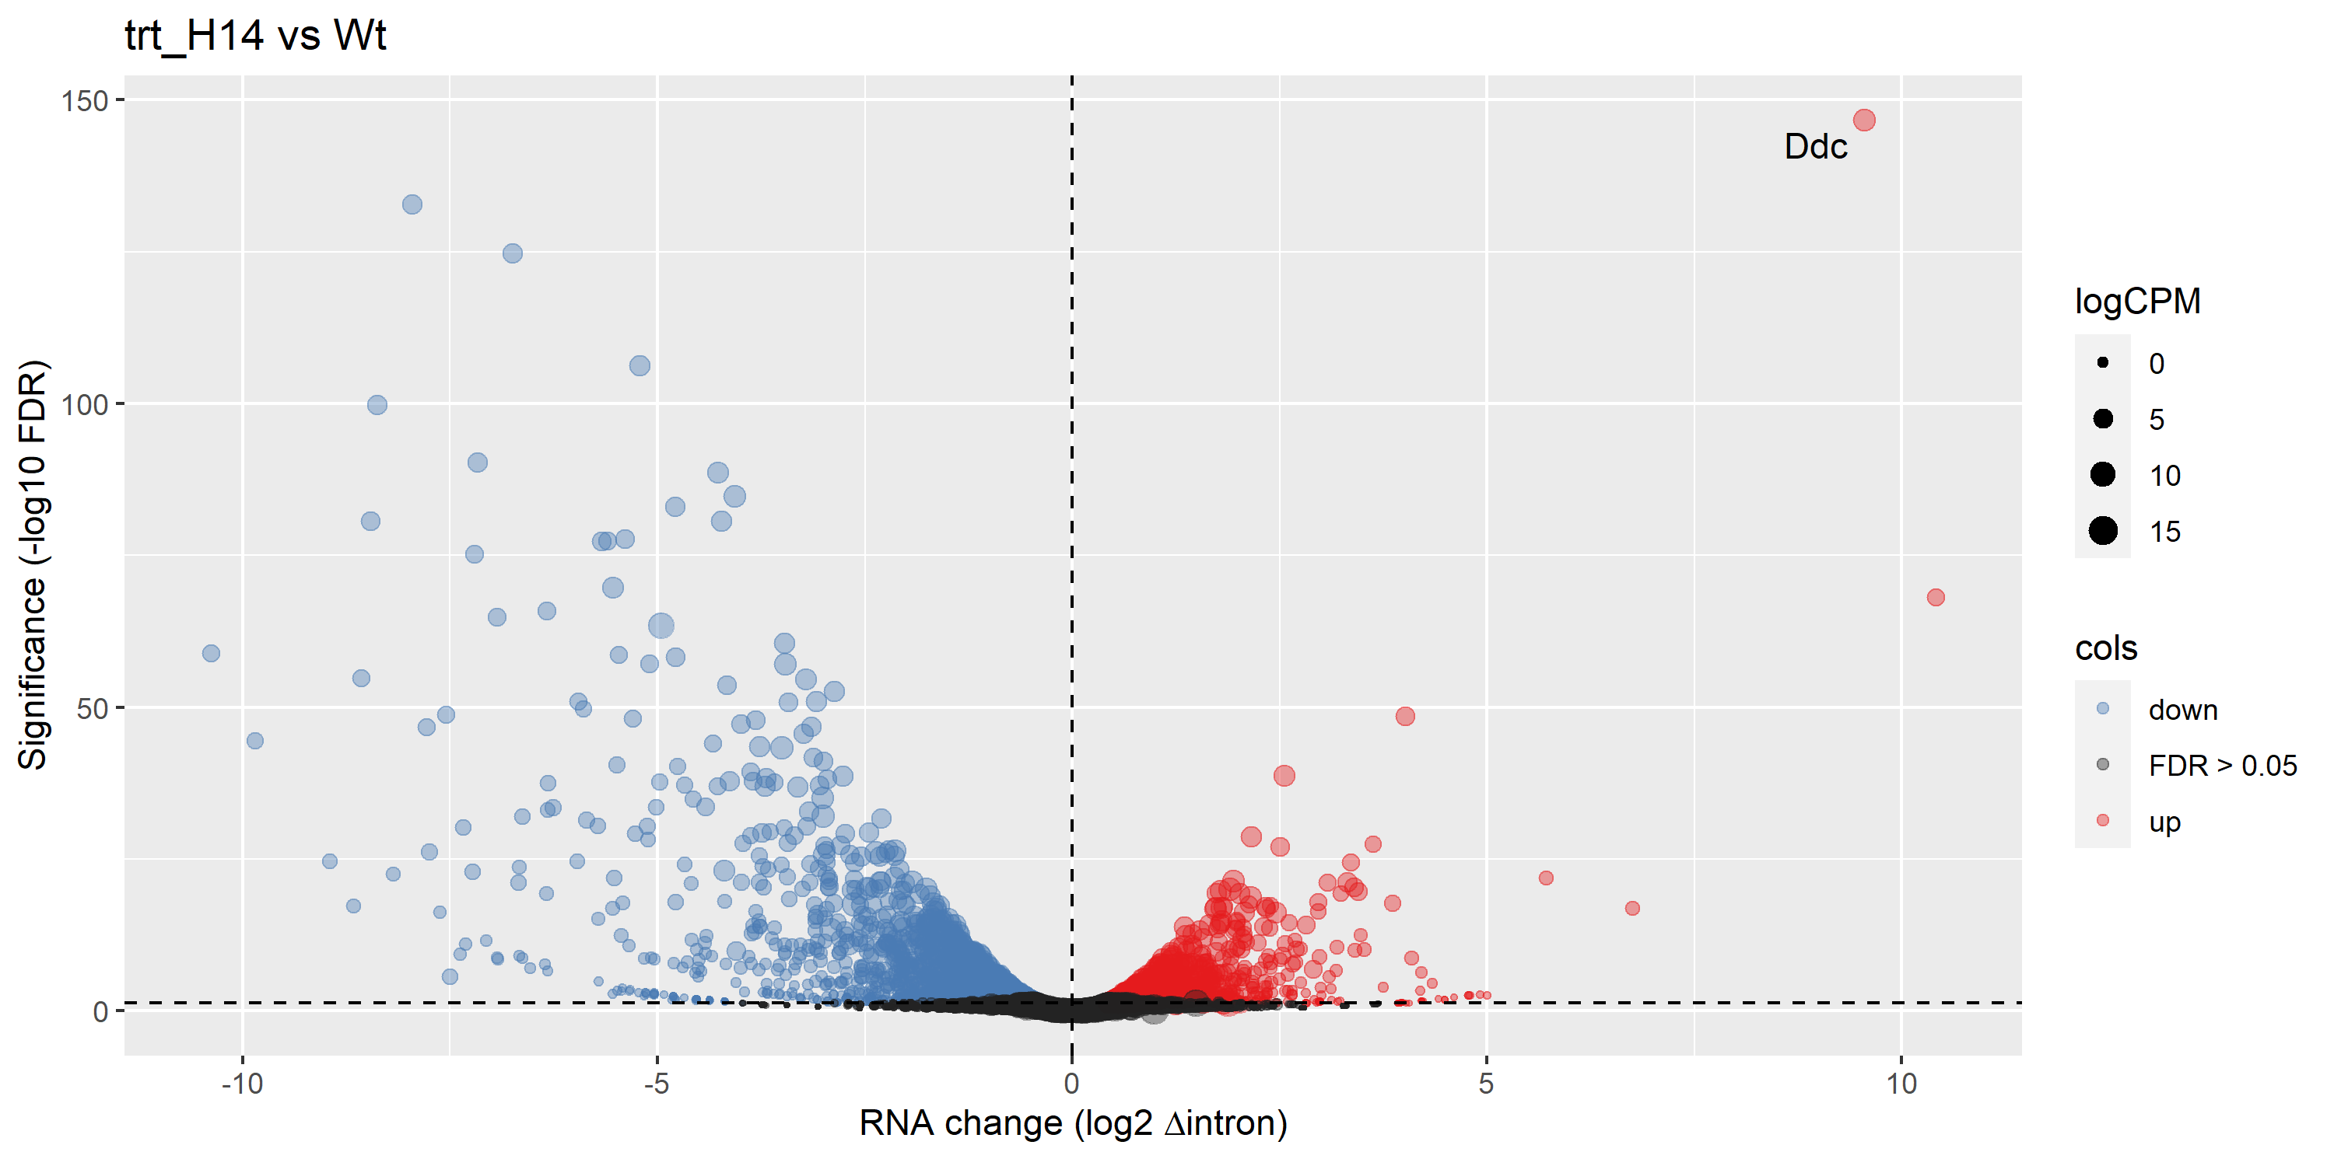
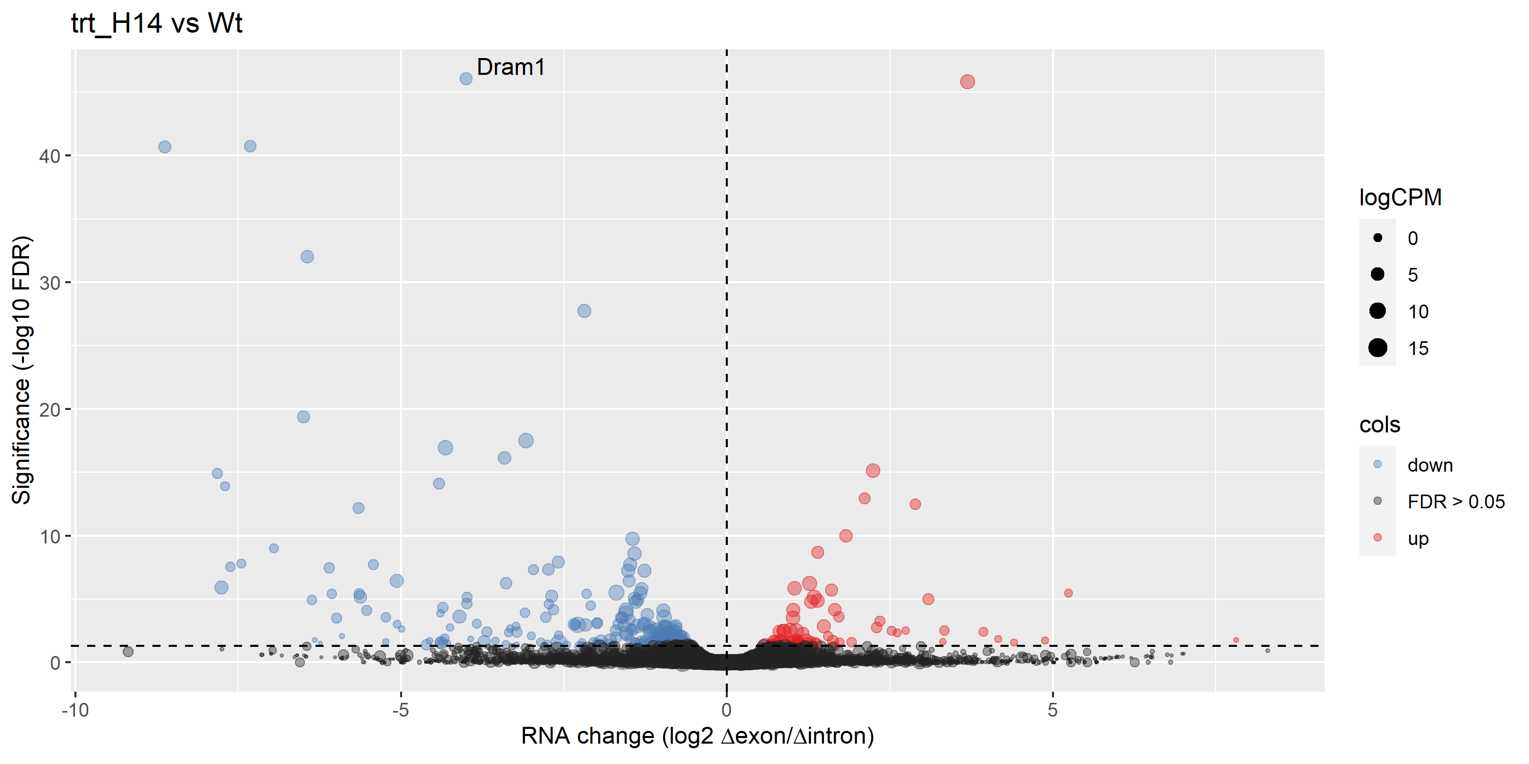
Volcano plots – no label
Exon
Up | 2492
Down | 2921
Intron
Up | 1348
Down | 1923
<- Differentially expressed exons/introns (post-transcriptionally regulated)

Slide 34
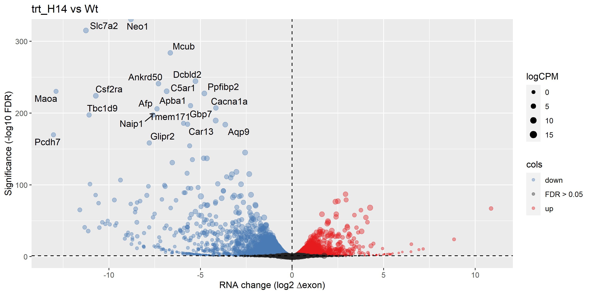
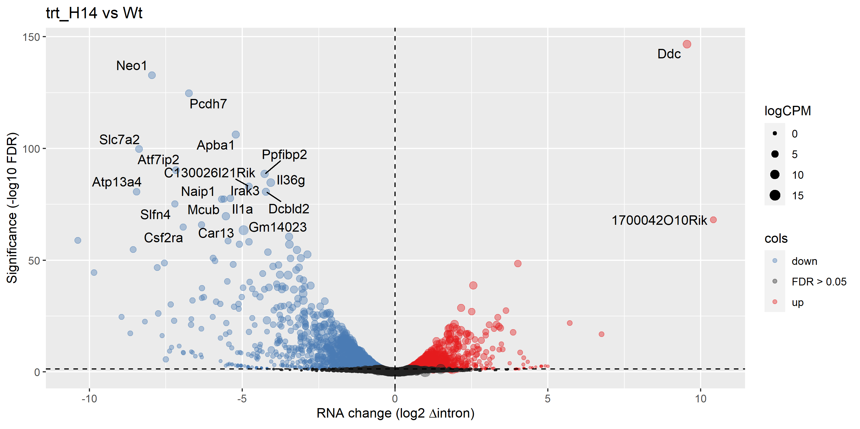
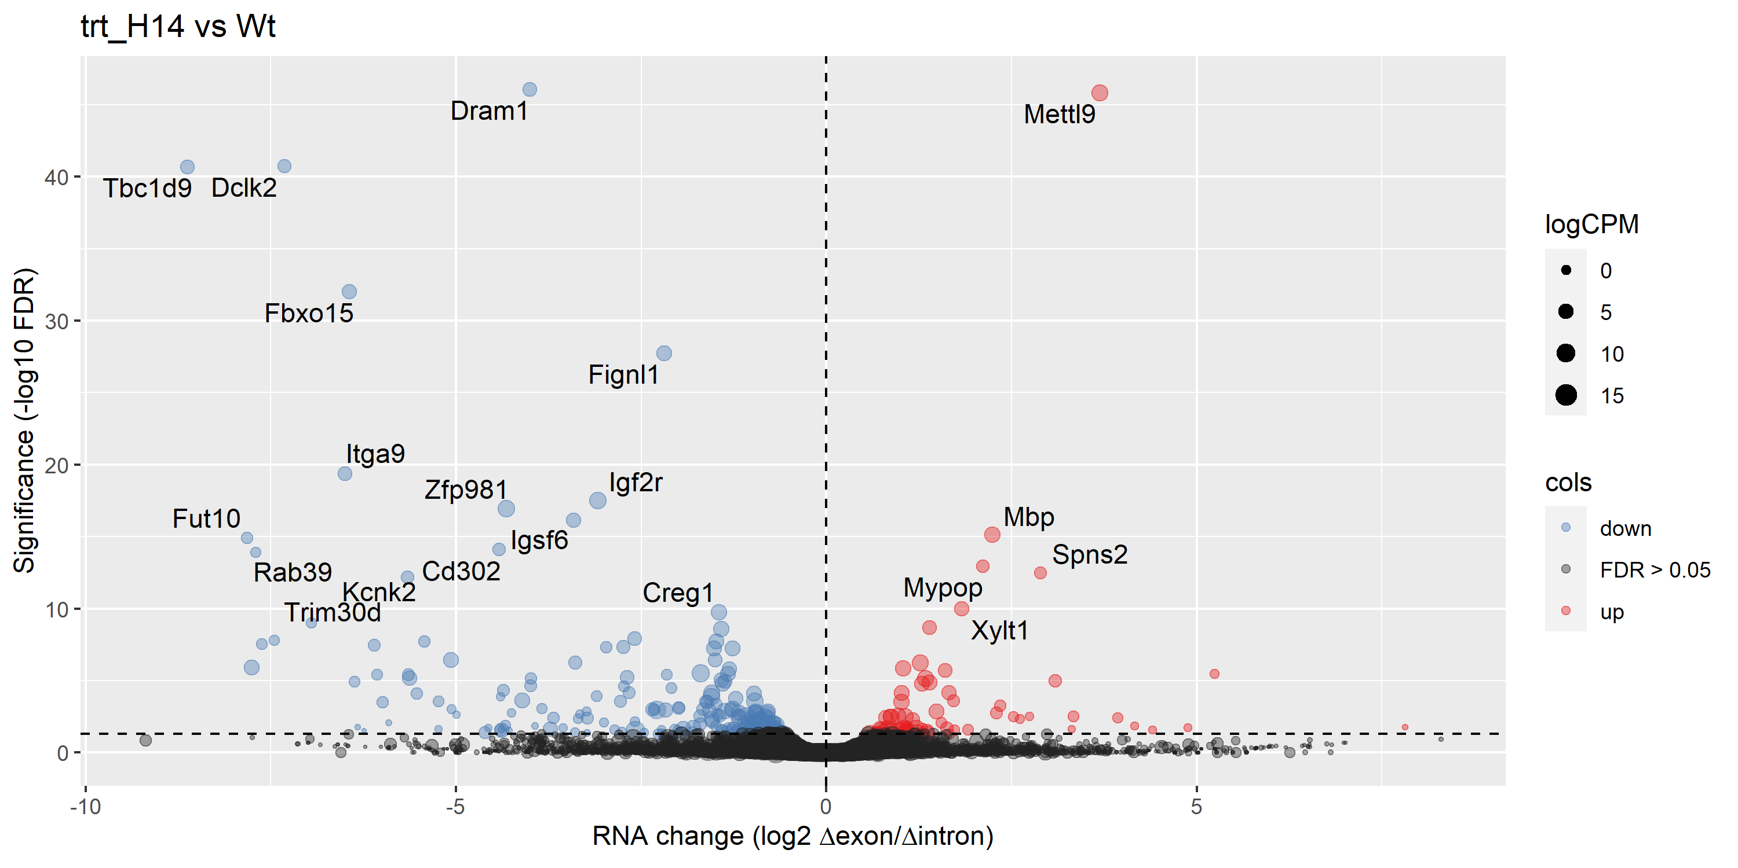
Volcano plots – top 20 genes labelled

Slide 35




Δ exon / Δ intron plots
Top 20 differentially expressed exons
R = 0.79819
p value < 2.2e-16
Top 20 differentially expressed introns
Top 20 most likely post-transcriptionally regulated genes
Pearson coefficient close to 1: changes in expression are largely due to changes in nascent transcription rather than post-transcriptional modifications
Genes that are likely to be post-translationally regulated are coloured

Slide 36


WT vs H14 after LPS
 |  | H14
 |  | Up | Down | Not significant
WT | Up | 2117 | 29 | 1434 | 3580
 | Down | 15 | 1779 | 1603 | 3397
 |  | WT
 |  | Up | Down | Not significant
H14 | Up | 2117 | 15 | 304 | 2436
 | Down | 29 | 1779 | 358 | 2166

